Slide 1

WNE UW
Topic 2.1
Overview the main concepts in microeconomics;
Why Computer Algebra System
Notes:
1

Slide 2
What was the reason to introduce computational methods to microeconomics?
In my opinion, microeconomic lectures should be:
More practical and less formal / we should create a solution to real-life problems.
More scientific / we should ask the question, not just calculate equilibrium points or prove the long-established theorems which they are easily find found in any advanced textbook.
More heterodox, less orthodox/ we should know the different schools of economics: Austrian, Marxist, econophysics, behavioural, …
For me, computational and experimental methods are good tools to achieve the goal.

Slide 3
Computational methods in our lectures
Computational methods:
Deterministic experimenting with models using Symbolic computation (Maxima) (today) / testing of external and internal validity of the model.
Experiment with randomness
Monte Carlo and Bootsproap experiments (R-CRAN)
Agent-based Computational Economics (NetLogo)

Slide 4
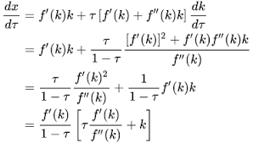
Overview the main concepts in microeconomics
The core of the Know Thyself method is finding the story about us/our society inside the formulas, not to conduct the simple calculus. Think not Calculate!!!
Is there any narrative/story about us in mathematical formulas?
For these formulas/models to take a given form, they must be based on assumptions. These assumptions are often hidden, unspoken, and indisputable.

Slide 5
Why Computer Algebra System PART 1

Slide 6
The first reason (strictly economic) to introduce symbolic computation to microeconomics
My observations: from intermediate microeconomics courses: Students spend on calculus almost 75% of the time. There is no time for results interpretation and creating links to the actual economic problems.
Using a purely economic approach, we should move away from the pen and paper calculations. It is a waste of time. We should use Computer Algebra System program to reduce time spent on simple calculus.
Computer Algebra System programs are excellent in visualization too.

Slide 7
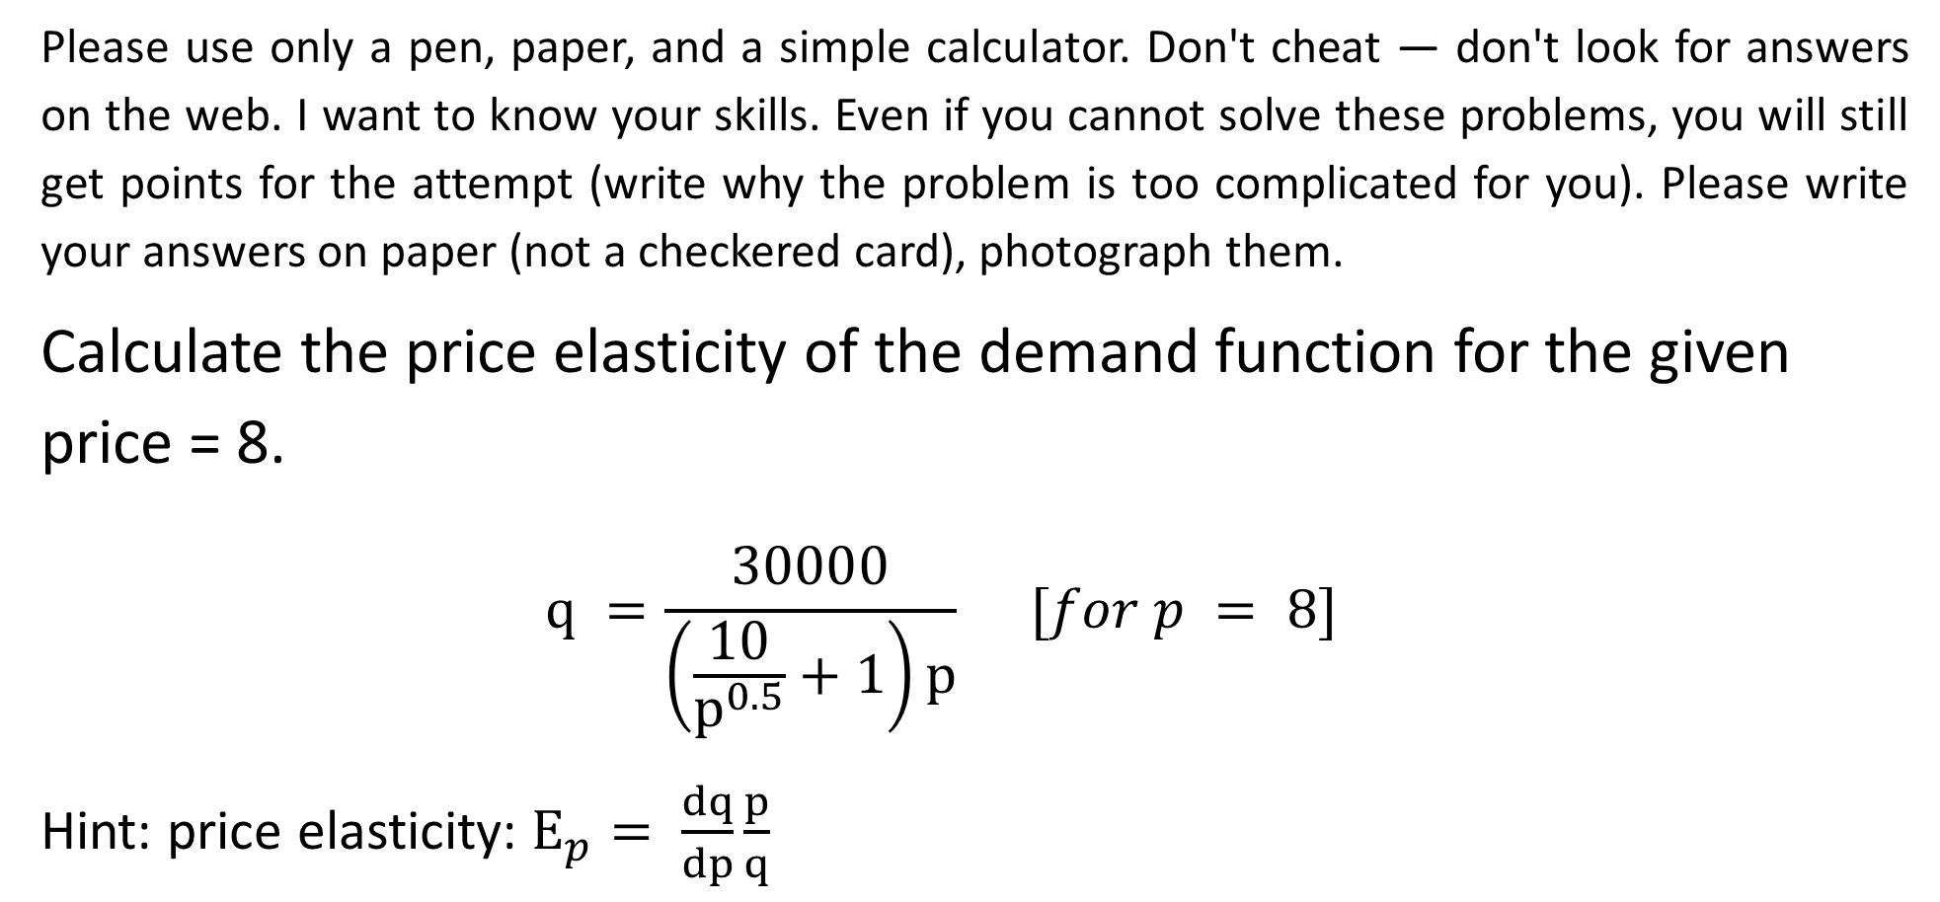
Math Test part 1
Please use only a pen, paper, and a simple calculator. Don't cheat — don't look for answers on the web. I want to know your skills. Even if you cannot solve these problems, you will still get points for the attempt (write why the problem is too complicated for you). Please write your answers on paper (not a checkered card), photograph them.
Calculate the price elasticity of the demand function for the given price = 8.
$$q =\frac{30000}{\left(\frac{10}{p^{0.5}}+1\right)p} [for p = 8]$$
Hint: price elasticity: $E_{p}= \frac{dq}{dp}\frac{p}{q}$

Slide 8
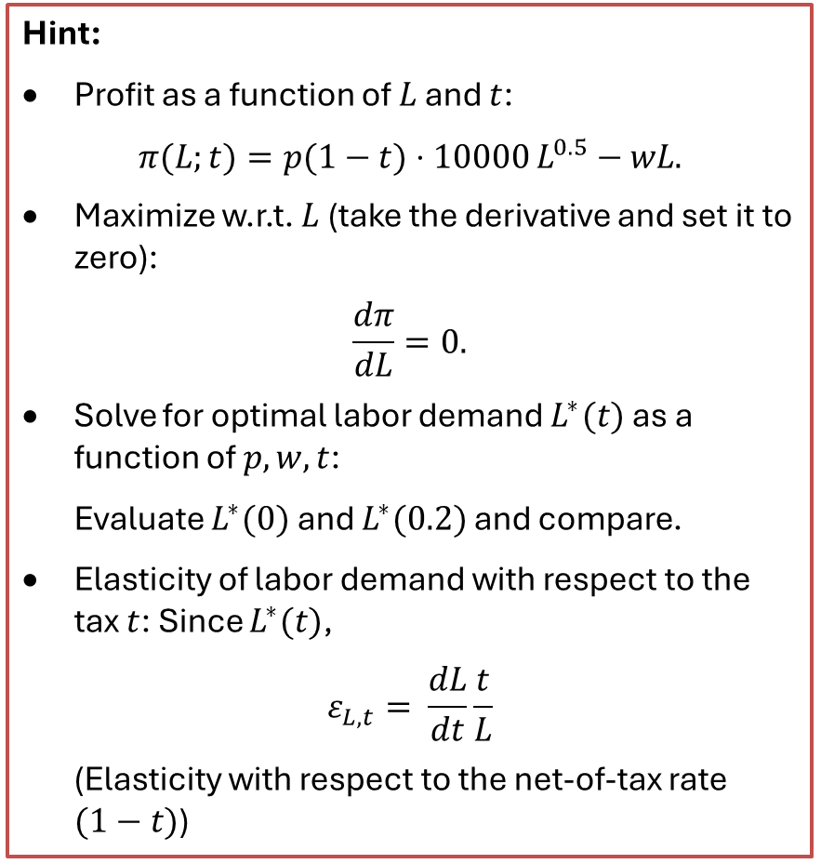
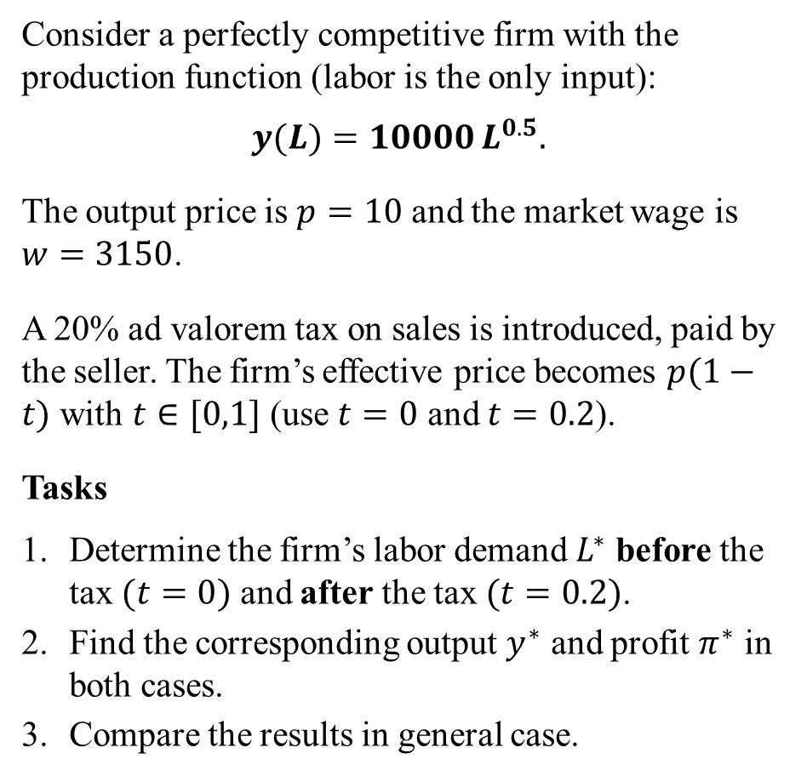
Math Test part 2
Consider a perfectly competitive firm with the production function (labor is the only input):
$$y(L)=10000 L^{0.5}.$$
The output price is $p=10$ and the market wage is $w=3150$.
A 20% ad valorem tax on sales is introduced, paid by the seller. The firm’s effective price becomes $p(1−t)$ with $t∈[0,1]$ (use $t=0$ and $t=0.2$).
Tasks
Determine the firm’s labor demand $L^{∗}$ before the tax $(t=0)$ and after the tax $(t=0.2)$.
Find the corresponding output $y^{∗}$ and profit $π^{∗}$ in both cases.
Compare the results in general case.
Hint:
Profit as a function of $L$ and $t$:
$$π(L;t)=p(1−t)⋅10000 L^{0.5}−wL.$$
Maximize w.r.t. $L$ (take the derivative and set it to zero):
$$\frac{dπ}{dL}=0.$$
Solve for optimal labor demand $L^{∗}(t)$ as a function of $p,w,t$:
Evaluate $L^{∗}(0)$ and $L^{∗}(0.2)$ and compare.
Elasticity of labor demand with respect to the tax $t$: Since $L^{∗}(t)$,
$$ε_{L,t}= \frac{dL}{dt}\frac{t}{L}$$
(Elasticity with respect to the net-of-tax rate $(1−t)$)

Slide 9
Math Test part 2
Please photograph your handwritten answers. Later in the lecture, I’ll show you how to solve these problems in Maxima. Add the computed results, combine them with your handwritten work, and submit everything as a single PDF file. Use the proper tool: Topic 2.1 → Tool to send the lecture task — math test.
Goal: I don’t care how you get the result — by hand, CAS, or AI — as long as it’s efficient and reliable.
This kind of work simply proves that you’re active during the lecture. You’ll get points even if your results aren’t correct — but don’t waste your time; do something useful during the class.

Slide 10
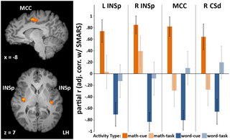
Math Test
I want to apologize that I have hurt you with the computational math test -> I activated the brain area (more or less) that react to the physical sensation of pain. Mathematics hurts - it was proven by research ☺
http://www.plosone.org/article/info%3Adoi%2F10.1371%2Fjournal.pone.0048076
Is solving the tasks worth the pain? No.
And I am going to introduce symbolic computation (+AI) [Computer Algebra System MAXIMA] as a solution.

Slide 11
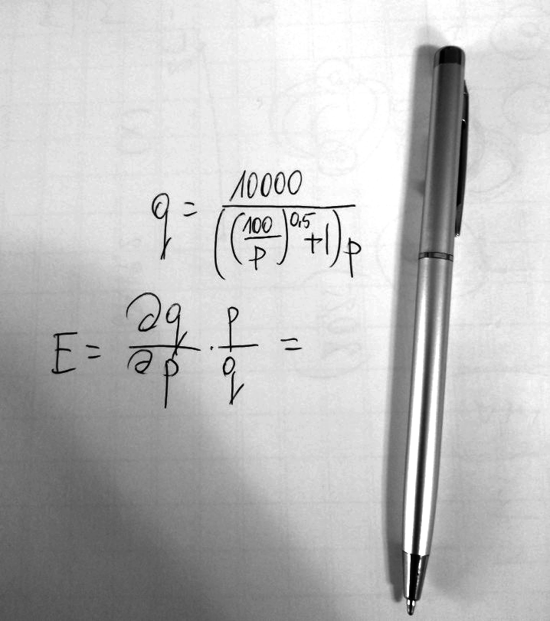

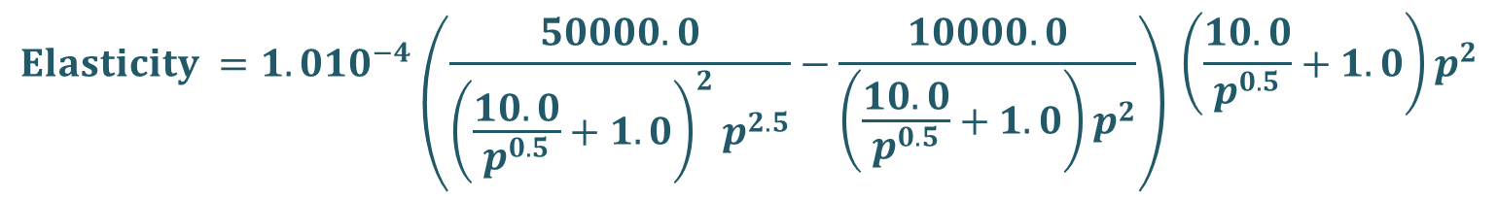
The first reason (strictly economic) to introduce symbolic computation to microeconomics
$$The demand function q =\frac{10000.0}{\left(\frac{10.0}{p^{0.5}}+1.0\right)⁢p}$$
$$Elasticity =1.0⁢{10}^{−4}⁢\left(\frac{50000.0}{{\left(\frac{10.0}{p^{0.5}}+1.0\right)}^{2}⁢p^{2.5}}−\frac{10000.0}{\left(\frac{10.0}{p^{0.5}}+1.0\right)⁢p^{2}}\right)⁢\left(\frac{10.0}{p^{0.5}}+1.0\right)⁢p^{2}$$
Let's compare the time-consuming pen-and-paper calculations with a simple modification of code. We can use this chunk of code to obtain price elasticity for any demand function. You have only to modify one line of code.
kill(all)$
q: 30000/(p*(1+(100/p)^0.3));
E_p: diff(q,p,1)* (p/q);
p: 8;
ev(E_p);
You can modify the code, copy the whole cell to Maxima and run --> Shift + Enter.

Slide 12
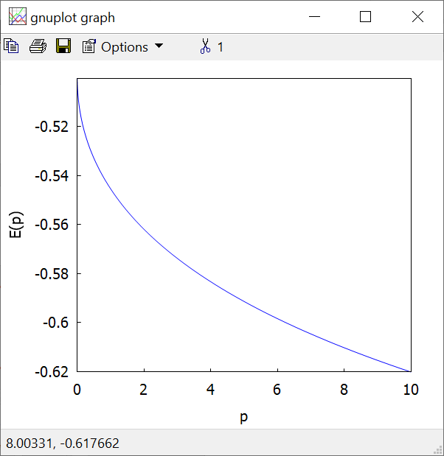
The first reason (strictly economic) to introduce symbolic computation to microeconomics
kill(all)$
load(draw)$
q: 10000/(p*(1+(100/p)^0.5));
e: diff(q,p,1)* (p/q);
draw2d(
xlabel = "p",
ylabel = "E(p)",
explicit(''e,p,0,10));
Even more, you can quickly draw the elasticity as the function of price, and you can evaluate the function by using the graphical interface -> you obtain values (E, p) for a point marked by the cursor.

Slide 13
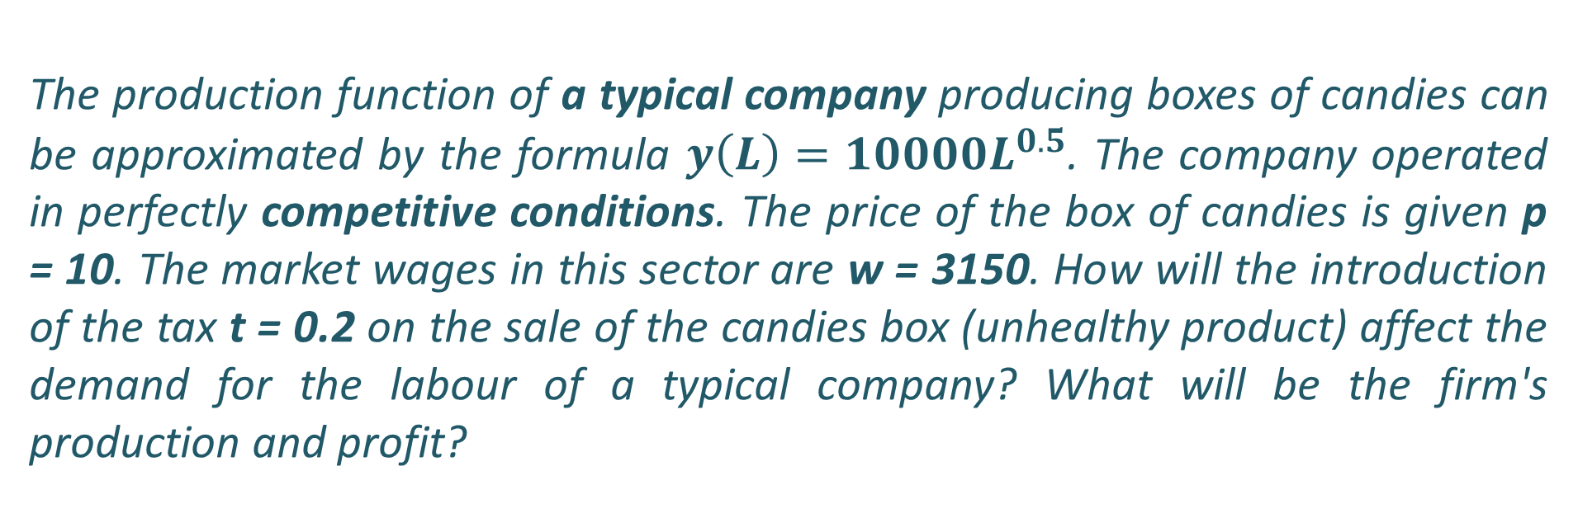
A typical intermediate microeconomic task? Think not calculate.
The production function of a typical company producing boxes of candies can be approximated by the formula $y\left(L\right)=10000L^{0.5}$. The company operated in perfectly competitive conditions. The price of the box of candies is given p = 10. The market wages in this sector are w = 3150. How will the introduction of the tax t = 0.2 on the sale of the candies box (unhealthy product) affect the demand for the labour of a typical company? What will be the firm's production and profit?

Slide 14
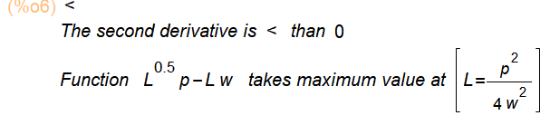
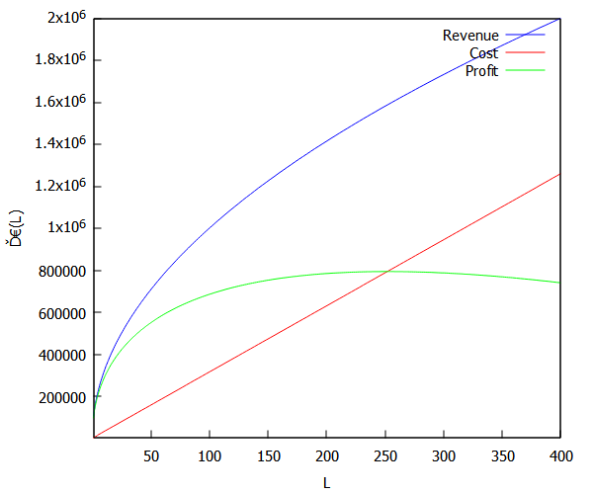
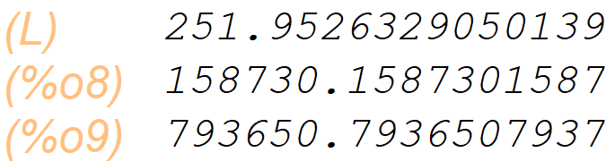
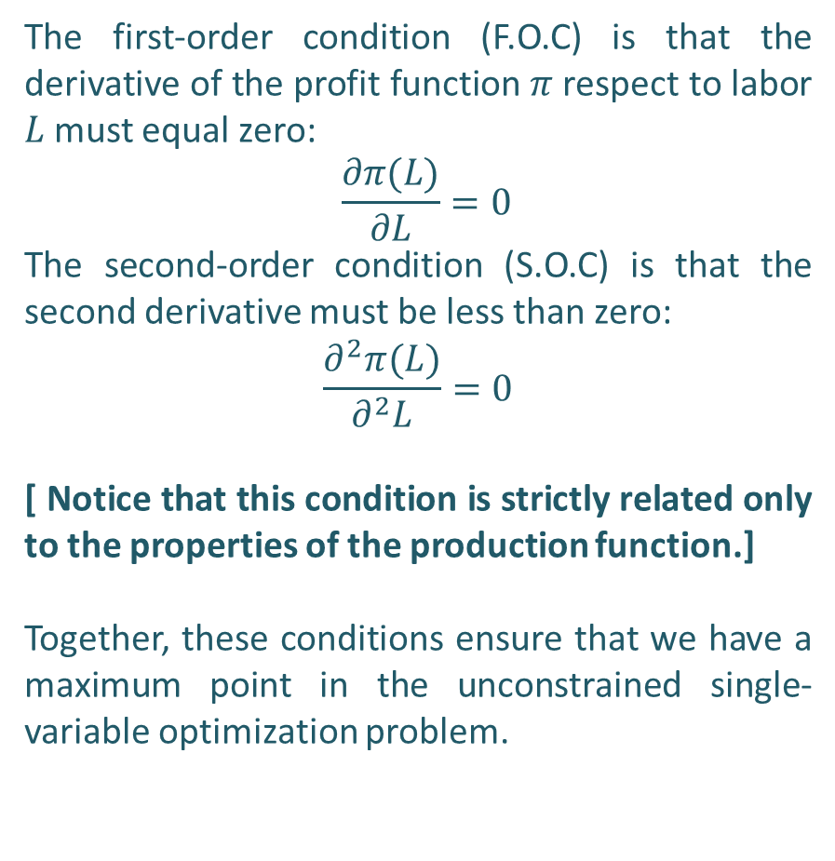
Extension of the model
and some mathematics
You can modify the code, copy the whole cell to Maxima and run --> Shift + Enter.
The first-order condition (F.O.C) is that the derivative of the profit function $π$respect to labor $L$must equal zero:
$$\frac{∂π(L)}{∂L}=0$$
The second-order condition (S.O.C) is that the second derivative must be less than zero:
$$\frac{∂^{2}π(L)}{∂^{2}L}=0$$
[ Notice that this condition is strictly related only to the properties of the production function.]
Together, these conditions ensure that we have a maximum point in the unconstrained single-variable optimization problem.
kill(all);
assume(Y>0, L>0, p>0, w>0)$
Y: L^0.5;
profit : p*Y - w*L;
eq1: diff(profit,L,1)=0;
Lhat: solve([eq1],[L]);
soc: compare( diff(profit,L,2),0);
print("The second derivative is", soc, " than",0) $
print("Function ", profit, " takes maximum value at",Lhat) $
kill(all);
assume(Y>0, L>0, p>0, w>0)$
Y: 10000*L^0.5;
profit : p*Y - w*L;
p:10;
w:3150;
draw2d(
xlabel = "L",
ylabel = "π(L)",
color = blue,
key = "Revenue",
explicit(p*''Y,L, 1, 400),
color = red,
key = "Cost",
explicit(w*L,L, 1, 400),
color = green,
key = "Profit",
explicit(profit ,L, 1, 400))$
kill(all)$
/* prices */
p:10;
w:3150;
/* enter the production function */
y:10000*L^0.5;
/* enter the profit function */
profit: p*y - w*L;
/* calculate f.o.c*/
eq1: diff(profit,L,1) = 0;
float(solve (eq1,L));
L : rhs(%[1]);
ev(y);
ev(profit);

Slide 15
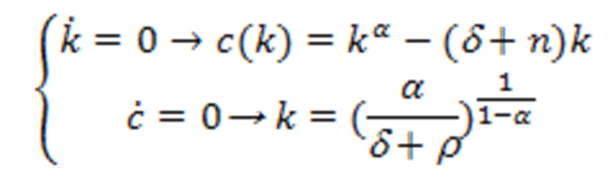
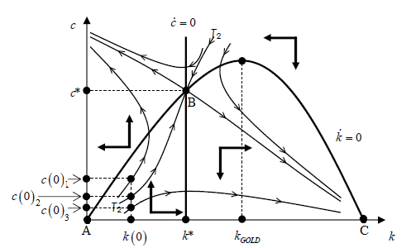
The first reason (strictly economic) to introduce symbolic computation to microeconomics
There are more sophisticated ways of using graphical capabilities of CAS.
The Ramsey growth model is very hard to visualise. The time path of consumption and capital depends on sets of parameters and the starting point.
It is hard to analyse the phase diagram.
My students prepared interactive materials as their macroeconomic assignments.

Slide 16
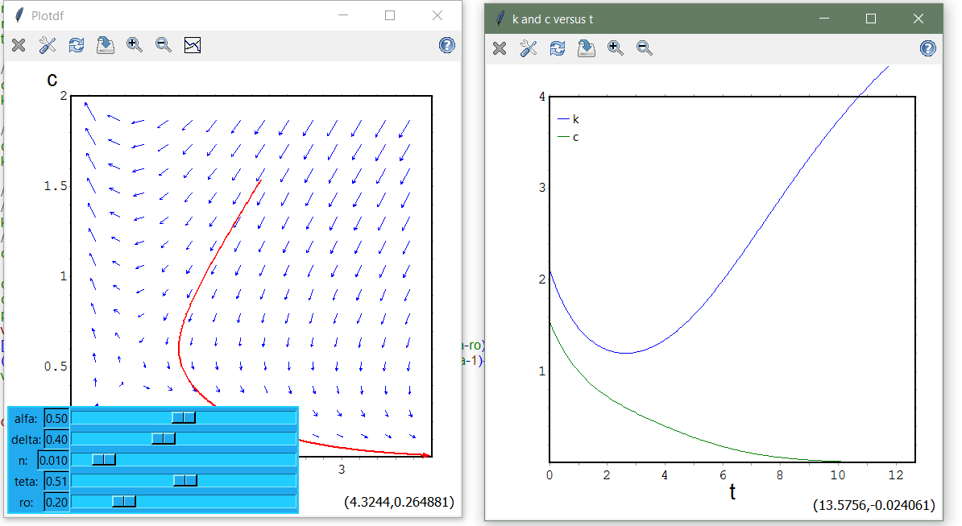
The first reason (strictly economic) to introduce symbolic computation to microeconomics
In Maxima, the phase diagram is interactive, so we can change parameters and set up the starting point :)
kill(all);
plotdf(['(k^(alfa)-c-(delta+n)*k) ,' (c/teta*(alfa*k^(alfa-1)-delta-ro))], [k,c],[k,0,4], [c,0,2],
[parameters,"alfa=0.5,delta=0.2,n=0.01,teta=0.2,ro=0.2"],[sliders,"alfa=0:1,delta=0:1,n=0:0.1,teta=0:1,ro=0:1"],
[tstep,1],[nsteps,300],[direction,forward]);
Run the code and experiment with the parameters using sliders. To start the experimentations:
click any point on the diagram space - the starting values of capital and labour
click reloads icon to clear previous results
click the graph icon to see the time paths

Slide 17
The first reason (strictly economic) to introduce symbolic computation to microeconomics
I hope I have proven to you how much of a waste of time it is to focus on calculations during the math test. For some, these are trivial calculations, but they don't know why they calculate; for others, the calculations are demanding, and they don't know why they calculate too.
I wrote a lot of codes for most of the topics of advanced microeconomics I prepared rich visualizations and animations – you have to just copy and change your personal numbers and focus on the problem: can the model be used to describe a real economic problem? What is the internal external validity of the model? The external validity will be your subjective judgment. But for economists, it is a part of the job to make such a judgement.

Slide 18
To extract stories, you need to start from the basics.
We need a deep understanding of:
Economics itself
Microeconomics itself
Homo oeconomicus (an economic creature)
The equilibrium concept in economics
Ceterbus Paribus principle
Comparative statics method
Marginal values in economics - revolution

Slide 19
Economics ?
How would you define economics?
Answer the question by yourself, NOW
Ask Chat or Google it
Which definition is correct / gives you a deep understanding of the concept?
There are many definitions of economics as a social science... some of them are blah, blah, blah - a lot of details, no essence.

Slide 20
Economics
Economics is the study of human behavior in situations of limited resources.
Economics is the science which studies human behaviour as a relationship between ends and scarce means which have alternative uses. [Lionel Robbins, 1932]
All "schools" of economics agree with this definition.
Definition ad absurdum:
There is no economics when resources are unlimited—then we have paradise or communism, depending on your ideology.
Example: 50 years ago, no one talked about the economics of fresh air. Fresh air was considered a free good, and free goods are not a subject of interest in economics.

Slide 21
Economics
Free goods are, i) available in unlimited quantities to everyone ii) the cost of obtaining them is zero for society (not produced by people - natural origin).
Which of the following goods is a free good?
a. Solar radiation
b. Fresh air
c. Public healthcare
d. Drinking water (freshwater)
e. Public television
It is becoming increasingly difficult to find example of free goods. Unfortunately, your generation will live in a world where all goods become scarce (or someone's property). Everything is becoming a subject of economic interest.

Slide 22

Economics
Philosophers often point out that we live in an economy of surplus, not scarcity. But surplus breeds scarcity.
The concept of attention economy was first coined in the late 1960s by Herbert A. Simon, characterizing the problem of information overload as an economic one. However, the concept has become increasingly popular with the rise of the internet making content (supply) increasingly abundant and immediately available, and attention becoming the limiting factor in the consumption of information.
https://www.un.org/sites/un2.un.org/files/attention_economy_feb.pdf
We used to refer to an information economy. But economies are defined by scarcity, not abundance (scarcity = value), and in an age of information abundance, what’s scarce? A: Attention. The scale of the world’s largest companies, the wealth of its richest people, and the power of governments are all rooted in the extraction, monetization, and custody of attention.
https://medium.com/@profgalloway/attentive-639d87091859

Slide 23
Micreconomics
How would you define micreconomics?
Answer the question by yourself, NOW
Ask Chat or Google it
Which definition gives you a deep understanding of the concept?

Slide 24
Microeconomics; an atomistic view of human behavior
My definition:
Microeconomics (orthodox view) is the study of the behavior of households, firms, markets, economies, and even societies as a result of individual actions in situations of limited resources.
This definition highlights two important aspects:
i) Microeconomics is the foundation of orthodox economics.
ii) The atomistic approach simplifies reasoning and, thanks to this, can model all aspects of human life and social behaviours — thus, microeconomic imperialism conquered all social sciences.

Slide 25
Microeconomics; an atomistic view of human behavior
Atom /
To understand how people behave in a given situation (constraints), economists create models based on the concept of the "economic man" (homo oeconomicus).
It is the most crucial foundation of neoclassical (orthodox). This model assumes that individuals are free in their choices and that all decisions they make are aimed at maximizing their utility, which can be understood as happiness, pleasure, or the achievement of desired life goals. The model excludes ethical considerations or judgments about "good" or "bad" goals. In this sense, economics remains neutral, focusing solely on the process of decision-making rather than the content or morality of those decisions.

Slide 26
Microeconomics; an atomistic view of human behavior
Microeconomic imperialism refers to the application of the homo oeconomicus model to the analysis of all socio-economic phenomena—the infiltration of economics into psychology, sociology, anthropology, and more. Economics explains: addictions, crimes, partner selection, marriages, divorces, childbearing, gambling, transplantology, suicides, religious practices, obesity, terrorism, and so on.
The master: Becker, G. The Economic Approach to Human Behavior
Test me: (on forum) give me any topic that you don’t associate with microeconomics, and I will give you an economic theory for it.

Slide 27
Microeconomics; an atomistic view of human behavior
Market:
Individuals, or "atoms," meet in markets to exchange goods or services. In economics, we always assume that we play one of two roles: consumer or producer. Markets can be formal or informal, and exchanges can involve money or other mediums of exchange. Abstract goods can also be traded, and abstract mediums of exchange (money) can be used.
The entire economy (even society) is a collection of interdependent markets where prices are established, determining the value of goods.

Slide 28
Microeconomics; an atomistic view of human behavior
Eric Berne's Transactional Analysis / Psychology (1964) is one of the best examples of "microeconomic imperialism." In Transactional Analysis, human interactions are analyzed as transactions in which people exchange resources—not only in an economic sense but also emotionally and socially. An example of this can be the analysis of interpersonal relationships as "markets" where emotional resources such as feelings, support, or recognition are exchanged. Berne analyzed human interactions in terms of "games" that people play to achieve psychological benefits. Every interaction between individuals is viewed as a kind of "game," where participants exchange "strokes," or different forms of recognition or rejection.

Slide 29
Microeconomics; an atomistic view of human behavior
Testing ideas from psychology to microeconomics; tester: Chatgpt
https://chatgpt.com/share/68e62a28-6094-8010-8831-2ad51a99da0c
I want to combine Eric Berne's Transactional Analysis (1964) with attention economics by Herbert Simon (1971)
It will be my draft of exam task / and a good idea for a master's thesis or even a doctorate / but it needs to be assessed very critically / such a combination does not exist in economic theory I also encourage you to comment on this idea on the forum. /If it works, I encourage you to write an article together /

Slide 30
Equilibrium - a bit of physics
What is equlibrium in economics?
Answer the question by yourself, NOW
Ask Chat or Google it
Which definition is correct / gives you a deep understanding of the concept?

Slide 31
Economics as social physics
The foundations of modern “neoclassical” economics were formed at the end of the 19th century. Economists were fascinated by the models of physicists. They thought that the application of mechanics to economic choices would allow them to precisely model the social world. To understand economics, one has to refer to these borrowings. Classical mechanics is a physical theory describing the motion of objects. The key concept is to calculate the resultant force in a given frame of reference (very often an object reduced to a point).
A digression: there is currently econophysics as a branch of physics. Economics physicists laugh at economists because classical mechanics is weak in modelling complex systems and economists missed 200 years of development and achievements of physical statistics and quantum mechanics (https://www.researchgate.net/publication/329897630_When_Financial_Economics_Influences_Physics_The_Role_of_Econophysics ) Richard Feynman on Pseudoscience
https://www.youtube.com/watch?v=tWr39Q9vBgo

Slide 32

The idea of what forces operate in economic elections is old
It is not from the kindness of the butcher, the brewer or the baker that we expect our dinner, but from their regard to their own self-interest... (Every individual) intends only his own security, only his own gain. And he is in this led by an invisible hand to promote an end which was no part of his intention. By pursuing his own interest, he frequently promotes that of society more effectually than when he really intends to promote it.
Who wrote this passage? And the name of this book is ...
The basic force that sets the economy in motion is profit (self-interest) - the difference between benefits and costs. Costs and benefits can be broadly understood, not only financial.

Slide 33
Equilibrium - a bit of physics
The understanding of the concept of equilibrium, borrowed from physics, is the foundation of neoclassical economics. All models are constructed in a similar way — we seek equilibrium states. Let's do The Candy Experiment for a deep understanding of the concept. It is the simplest didactic tool I've ever created, but it has enormous explanatory power.

Slide 34
Equilibrium - a bit of physics - all neoclassical economics
Alfred Marshall (the father of neoclassical economics) improved upon the ideas of William S. Jevons and others who treated economics as social physics, in which profit is the driving force of our actions, but they were interested in equilibrium. "When all the forces acting on an object are in balance, the object is said to be in a state of equilibrium." Imagine a small ball at the bottom of a hemispherical bowl.
When unbalanced forces act on the ball, the ball moves (the ball will not be in equilibrium)
When the forces are balanced, the ball does not move (it will be in equilibrium)
Two opposing forces [components, vectors] act on this ball [ptofit]: cost and benefit.

Slide 35

Equilibrium - the candy experiment - homo oeconomicus
Benefit
5
4
3
2
1
Cost
2
2
2
2
2
You like candies and imagine that you are a homo oecoenomicus, so you want to have as many candies as possible. You can get these candies through your activity - by taking a step and taking candies. If you take one step, you can take those candies that are on the nearest table. Next step, you take candies from the next table etc ... Of course, nothing is for free in life. Each step costs you 2 candies for each step. If you go too far, you have to go back and then the costs of this step are returned and you give away the candies. Did you understand the rules of the experiment? How many steps will you take?

Slide 36
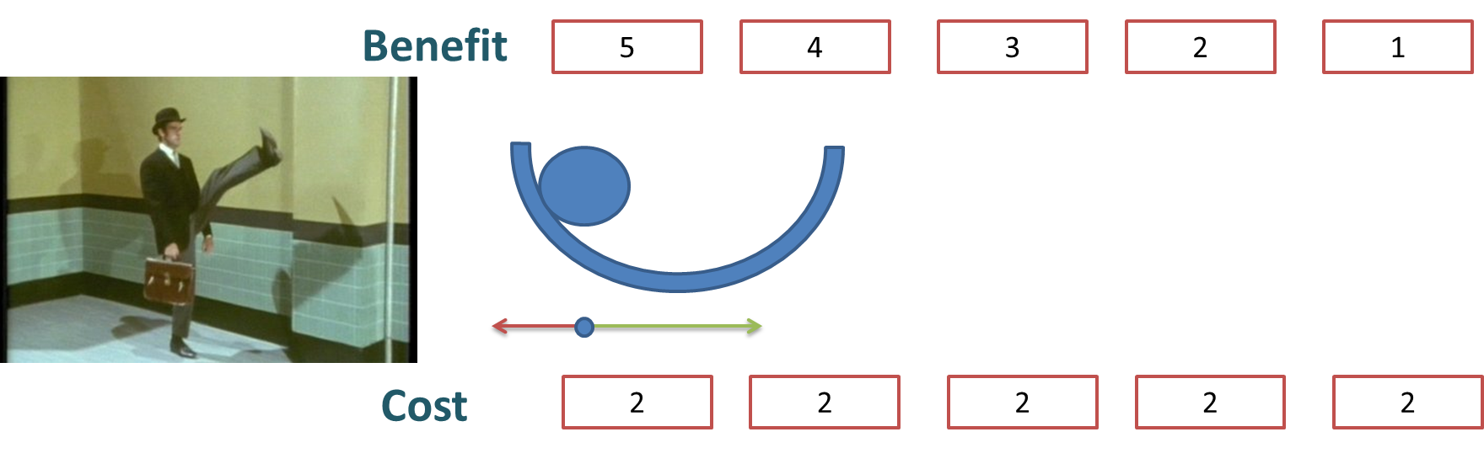
Equilibrium - the candy experiment - homo oeconomicus
Will you take the first step? -> Yes -> Why? Because for taking one step, You will receive 5 candies and You have to pay for this step 2, i.e. You will "earn" 3 candies. Will you take the next step? ...
Will you take the fourth step?
You lose nothing and gain nothing. It does not matter whether we take this step or not (you are indifferent). For didactic reasons, let you take this one step. A homo oeconomicus (you) is in equilibrium. We know where it will stop. After the third step, nothing pushes him to take the next step. If he takes a step forward, he will lose earnings. He will also lose if he withdraws. Like the ball in the bowl, HO is not influenced by any force that would change his position.

Slide 37
Equilibrium - the candy experiment - homo oeconomicus
Benefit
5
4
3
2
1
Cost
2
2
2
2
2
Equilibrium condition:
Marginal cost (of last step) = Marginal benefit (of last step)
MB = MC
The first derivative of the benefit function = the first derivative of the cost function

Slide 38
Equilibrium - the candy experiment - comparative statics
Benefit
5
4
3
2
1
Cost
2 + 1
2 + 1
2 +1
2 +1
2 +1
Let's change something in our system; you pay tax (t = 1) for every step you take and all other factors are constant (Ceterbus Paribus).
We look at how it will affect the equilibrium compared to the initial situation. (Comparative statics) - we compare two equilibrium points. Introducing taxes reduced economic activity (the number of steps taken).

Slide 39
Equilibrium - the candy experiment - homo oeconomicus
The core of microeconomics is finding equilibrium points. The benefits and costs are determined not by the placement of candies on the table but by functions, i.e. a mathematical approximation of benefits and costs. This approach (Margilalistic) has solved several economic problems and it is dominant today.
The diamond-water paradox: A diamond has little total utility compared to water. But we pay much more for a diamond than for water.
To explain this paradox, many economists built artificial logical constructions using the concept of total utility to explain the paradox. It was even reflected in Adam Smith's Wealth of Nations, who divided utility (value) into two types: "value in use" and "value in exchange".

Slide 40
Equilibrium - the candy experiment - homo oeconomicus
The paradox of value - The diamond water paradox
U(w)
Explaining this paradox is easy if we use marginal rather than total values. If we increase the number of diamonds consumed by one and the amount of water consumed by one litre, the utility change for the diamond will be enormous, and the water change of utility will be insignificant. Our subjective assessment of value depends on the gain in utility - that is, the marginal utility. We will pay very little for an additional diamond if everyone has a few kilos of diamonds. We will pay a lot of money for one litre of water if we are in a desert as castaways.
We consume a lot of water (150-200 litres daily). The total utility of water is very high. But we are willing to pay very little for the water.
water
U(d)
We consume few diamonds, and therefore the overall utility of diamonds is low, but we are willing to pay much more for diamonds than water.
diamonds

Slide 41

The candy experiment you can find everywhere in economics
A typical intermediate microeconomic task? Where is the Candy expeirment?
The production function of a typical company producing boxes of candies can be approximated by the formula $y\left(L\right)=10000L^{0.5}$. The company operated in perfectly competitive conditions. The price of the box of candies is given p = 10. The market wages in this sector are w = 3150. How will the introduction of the tax t = 0.2 on the sale of the candies box (unhealthy product) affect the demand for the labour of a typical company? What will be the firm's production and profit?

Slide 42
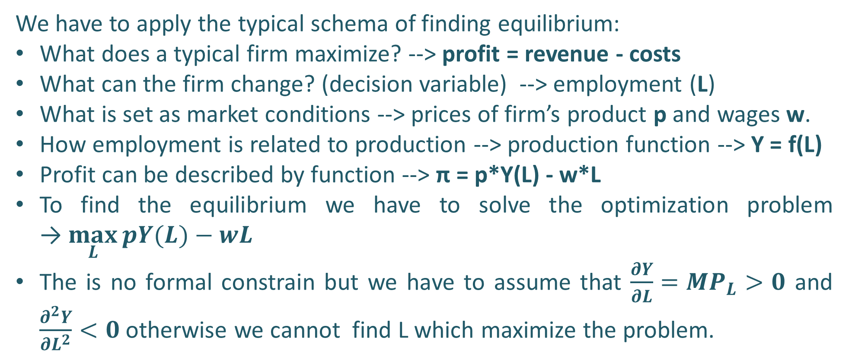
The candy experiment you can find everywhere in economics
We have to apply the typical schema of finding equilibrium:
What does a typical firm maximize? --> profit = revenue - costs
What can the firm change? (decision variable) --> employment (L)
What is set as market conditions --> prices of firm’s product p and wages w.
How employment is related to production --> production function --> Y = f(L)
Profit can be described by function --> π = p*Y(L) - w*L
To find the equilibrium we have to solve the optimization problem →$\max_{L}{pY(L)−wL }$
The is no formal constrain but we have to assume that $\frac{∂Y}{∂L}={MP}_{L}>0$ and $\frac{∂^{2}Y}{∂L^{2}}<0$ otherwise we cannot find L which maximize the problem.

Slide 43

The candy experiment you can find everywhere in economics
We have to find first order conditon $\frac{∂π}{∂L}=0→p\frac{∂y}{∂x}−w=0$
And now, we have the equilibrium condition p*MP = w.
First interpretation of the equilibrium condition:
p*MP = w
Marginal revenue (benefit) from the last employed worker (Marginal Revenue Product) )
wage - what we have to pay the worker (Marginal Cost).
Second interpretation: we have unconditional demand for labour:
p*MP = w → pMP(L) = w → f(L) = w → L = f(w)
(number of employees as a function of labor price)

Slide 44
The candy experiment you can find everywhere in economics
These are the equilibrium conditions and the relationship between wages and the number of employees -> that is, the demand for labour.
Example: Employer offers a job. Five candidates come and pass the test: how many units can they produce in a month? Market rates (given): wages w = 2000, product prices p = 100
Candidate | 1 | 2 | 3 | 4 | 5
Cost of the new employee | 2000 | 2000 | 2000 | 2000 | 2000
Worker Productivity (Production of Y ) | 100 | 60 | 30 | 20 | 10
Benefit per employee | 10 000 | 6000 | 3000 | 2000 | 1000
Profit | 8 000 | 4 000 | 1 000 | 0 | -1 000
Equilibrium in classical physics A body that is not affected by any force (or when the resultant force is zero) remains at rest or moves at a constant speed in a straight line.
Employer equilibrium: There is no force (no possibility of increased profit) that causes the employer to increase/decrease employment. This force is present in the case of 1, 2, or 3 workers. For the 4th employee: marginal costs = marginal benefit or MC = MR or p * MP = w. It is the equilibrium. The benefit of the marginal worker (PMP) is equal to the cost of his employment - they pay (w).

Slide 45
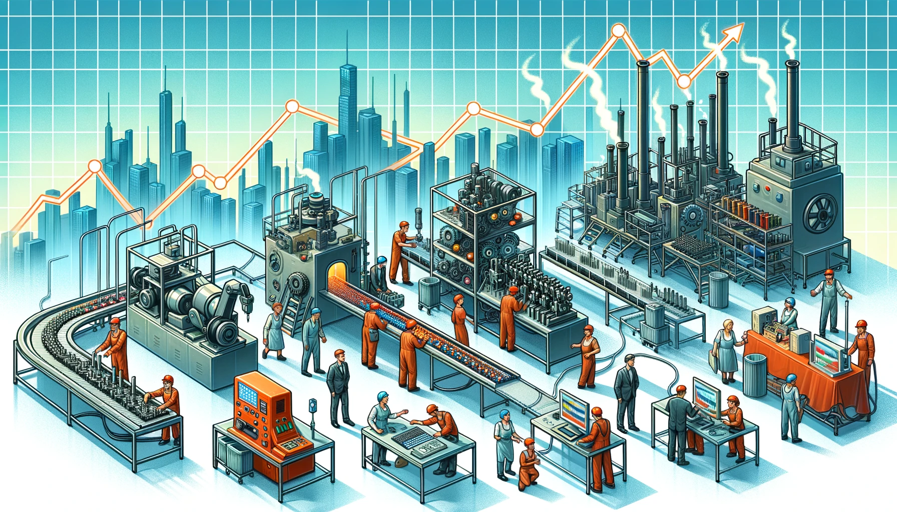
Principle of diminishing marginal productivity. A very important assumption that is usually true, but...
The image portrays a dynamic factory setting, emphasizing the concept of marginal productivity. Workers are seen actively engaged in various stages of production. Starting from the left, there's a clear progression from basic tools and methods to more advanced machinery, correlating with an increase in production. As you move further to the right, the production rate's increase starts to show signs of slowing down, indicating the principle of diminishing marginal productivity. Above this scene, a graph clearly depicts this production trend, with an upward curve that starts to plateau.
OpenAI. (2023). ChatGPT (September 25 Version) [Large language model]. https://chat.openai.com

Slide 46
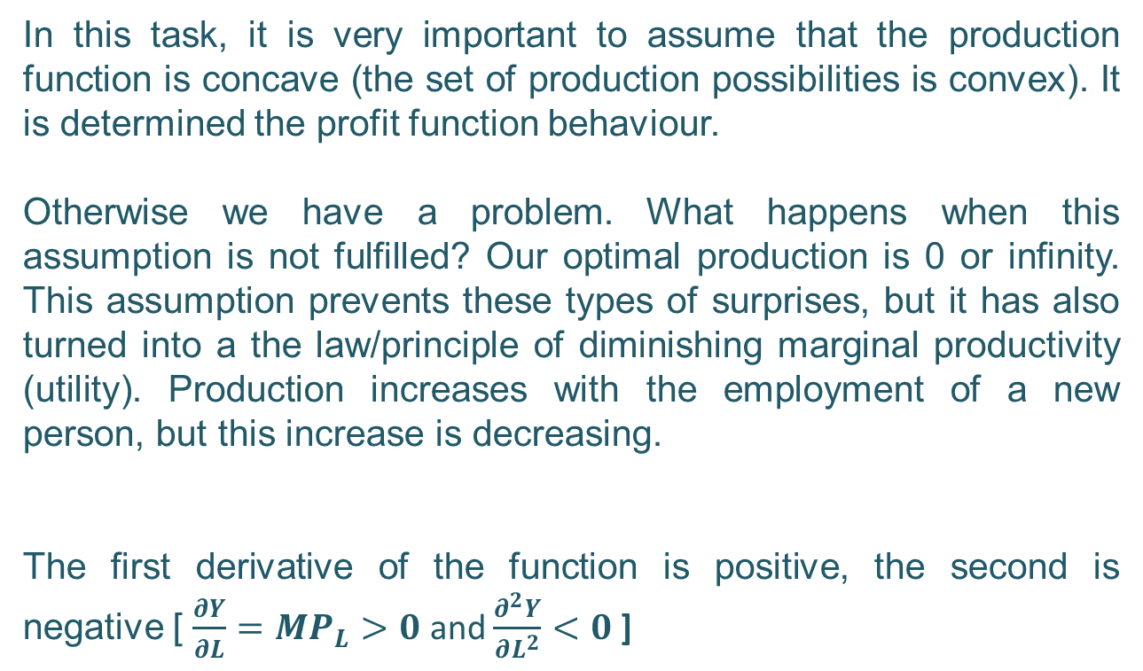
Principle of diminishing marginal productivity. A very important assumption that is usually true, but...
The point in below a function --> the function is concave
In this task, it is very important to assume that the production function is concave (the set of production possibilities is convex). It is determined the profit function behaviour.
Otherwise we have a problem. What happens when this assumption is not fulfilled? Our optimal production is 0 or infinity. This assumption prevents these types of surprises, but it has also turned into a the law/principle of diminishing marginal productivity (utility). Production increases with the employment of a new person, but this increase is decreasing.
The first derivative of the function is positive, the second is negative [ $\frac{∂Y}{∂L}={MP}_{L}>0$ and $\frac{∂^{2}Y}{∂L^{2}}<0$ ]
Y(L)
The point in inside a set --> the set is convex
L

Slide 47
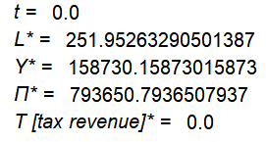
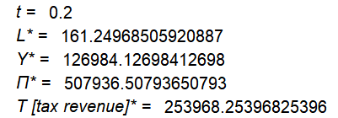
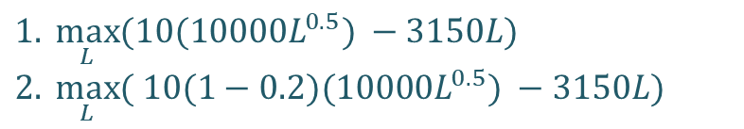
Comparative statistic
kill(all)$
/* enter the production function prices p, w and tax */
p:10$
w:3150$
t: 0.2$
/* enter the production function */
y:10000*L^0.5$
/* enter the profit function */
profit: p*(1-t)*y - w*L$
/* calculate f.o.c*/
eq1: diff(profit,L,1) = 0$
float(solve (eq1,L))$
L : rhs(%[1])$
/* outputs */
print("t* = ", ''t) $
print("L* = ", ''L) $
print("Y* = ", ''y) $
print("Π* = ", ''profit) $
Compute equilibrium before and after the intervention and compare the conditions. It means we have to solve two optimization problems:
$$1. \max_{L}{(10(10000L^{0.5}) −3150L)}$$
$$2.{\max_{L}{( 10(1−0.2)(10000L^{0.5}) −3150L)}}$$
Comparative statistic: Interpret how the introduction of the tax affects our equilibrium conditions..

Slide 48
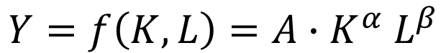
Extension of the model and some mathematics
The problem of profit maximization for a production function dependent on two variables: K and L. Where:
K - capital.
L - labor.
A - the efficiency of technology.
α - output elasticity of capital, indicating how much output changes with a 1% increase in capital, holding labor constant. A higher α means capital contributes more to production. (This will be discussed later.)
β - output elasticity of labor, showing the change in output from a 1% increase in labor, holding capital constant. A higher β means labor plays a bigger role. (This will be discussed later.)
p - price of the output.
r - interest rate — the cost/price of capital .
w - wage rate — the cost/price of labor .
$$Y=f\left(K,L\right)=A∙K^{α} L^{β}$$
The Cobb–Douglas form of the production function
(Approximately 80% of the cases, you will use this type of function.)
$$π=p\left(A∙K^{α} L^{β}\right)−(r∙K+w∙L)$$

Slide 49
Extension of the model and some mathematics
What conditions must be met to find the profit maximum?
Capital and labor are decision variables that can be changed (in the long run, all variables can be adjusted).
Conditions for maximizing a multivariable function without constraints:
First-Order Condition (F.O.C): The gradient (vector of the first derivatives) must equal zero.
Second-Order Condition (S.O.C): The Hessian matrix (matrix of second derivatives) must be non-positive definite. If the Hessian HH is non-positive definite, the function is concave. [ Notice that this condition is strictly related only to the properties of the production function.]

Slide 50
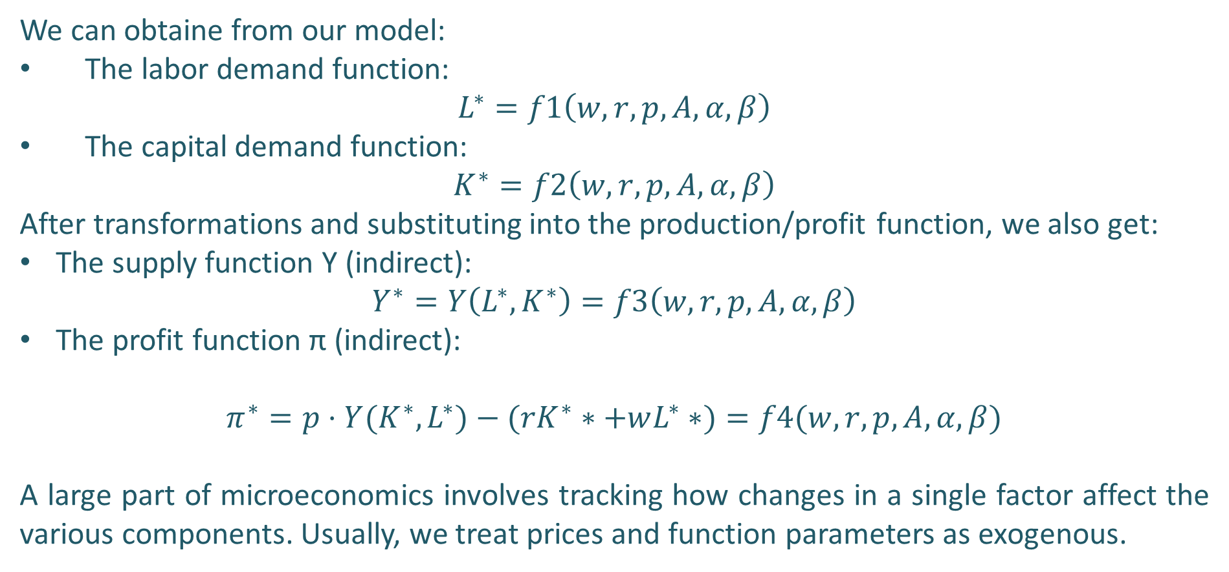
Extension of the model and some mathematics
We can obtaine from our model:
The labor demand function:
$$L^{∗}=f1\left(w,r,p,A,α,β\right)$$
The capital demand function:
$$K^{∗}=f2\left(w,r,p,A,α,β\right)$$
After transformations and substituting into the production/profit function, we also get:
The supply function Y (indirect):
$$Y^{∗}=Y\left(L^{∗},K^{∗}\right)=f3\left(w,r,p,A,α,β\right)$$
The profit function π (indirect):
$$π^{∗}=p⋅Y(K^{∗},L^{∗})−(rK^{∗}∗+wL^{∗}∗)=f4(w,r,p,A,α,β)$$
A large part of microeconomics involves tracking how changes in a single factor affect the various components. Usually, we treat prices and function parameters as exogenous.

Slide 51
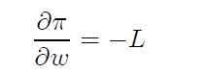
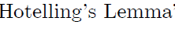
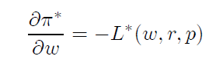
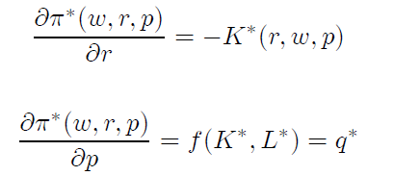
Extension of the model and some mathematics
In microeconomics, there are many shortcuts — you don’t always need to calculate, just understand. One such shortcut is Hotelling’s Lemma.
We are interested in how profit changes due to changes in w, r, or p. When we use the profit function directly, we often get a “strange” result.
Instead, we need to use an indirect function — one that depends on parameters. We find the optimal values of L*, K*, and Y*, then substitute them into the profit formula.
?
It will be continued after reviewing the CAS (Computer Algebra System).

Slide 52
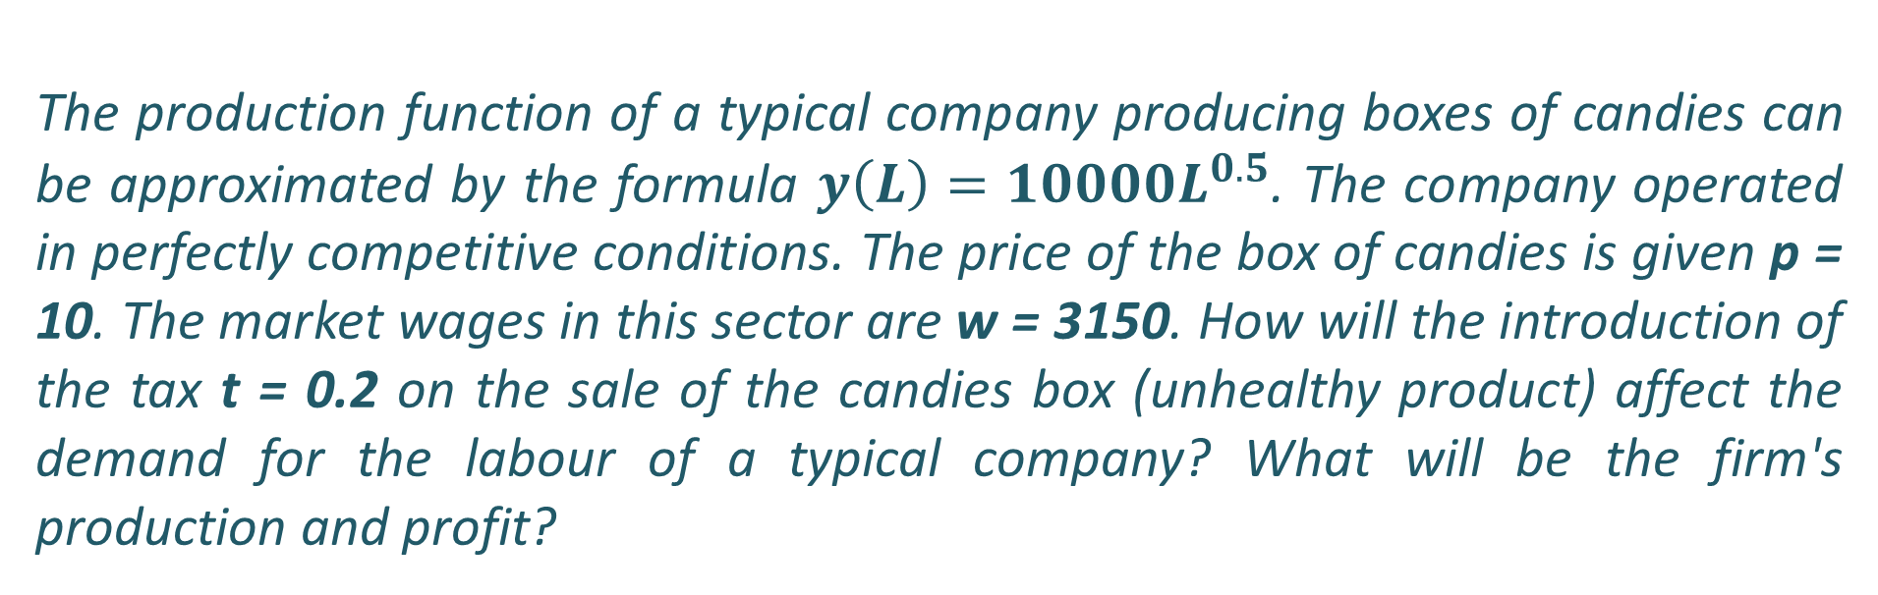
What about your intermediate microeconomic home task? What is the the stories inside the task?
The production function of a typical company producing boxes of candies can be approximated by the formula $y\left(L\right)=10000L^{0.5}$. The company operated in perfectly competitive conditions. The price of the box of candies is given p = 10. The market wages in this sector are w = 3150. How will the introduction of the tax t = 0.2 on the sale of the candies box (unhealthy product) affect the demand for the labour of a typical company? What will be the firm's production and profit?

Slide 53
Stories contained in equation
Have you ever dealt with a powerful narrative (storytelling) hidden in the model in your life? Especially in the equilibrium condition:
pMP = w
Has this narrative been used by you or your family, friends in any discussion?
Yes, or not?
Explain when if yes.

Slide 54
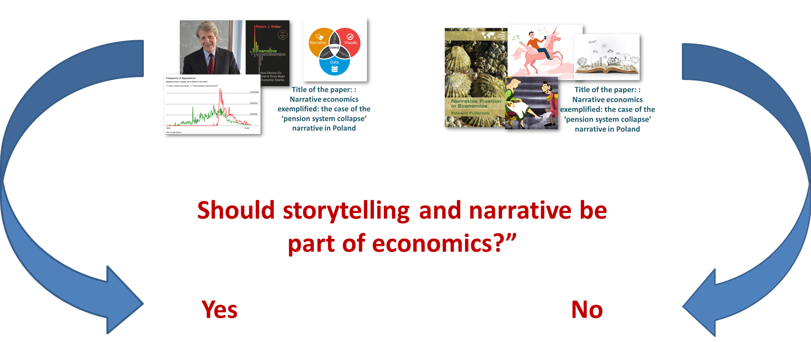
One equation : a lot of stories
pMP = w
Story 1: You deserve what you get
Two interpretations
Story 2 Atoms in competitive environment / there is no country for teamwork
Story 3 ….

Slide 55

Story 1: You deserve what you get the parable of the talents
It's one of the parables - a moral lesson about responsibility and making the most of one's abilities.
Summary of the Parable: A master is preparing to leave on a journey and entrusts three of his servants with different amounts of "talents," a unit of weight and money in ancient times. To one servant, he gives five talents, to the second servant, he gives two talents, and to the third servant, he gives one talent, each according to their abilities.
When the master returns:
The first servant has doubled his talents, turning the initial five into ten.
The second servant has also doubled his talents, turning two into four.
The third servant, however, out of fear, buried his talent in the ground and has only that one talent to return to his master.
The master praises the first two servants for their resourcefulness and diligence, rewarding them with greater responsibilities. However, he rebukes the third servant for his inaction, taking away his single talent and giving it to the servant with ten talents.
Moral of the Story: The Parable of the Talents is often interpreted as an encouragement to use one's gifts and abilities wisely and productively. Those who make the most of what they are given will be rewarded, while those who do nothing risk losing even the little they have. It underscores the values of responsibility, diligence, and the consequences of inaction.
OpenAI. (2023). ChatGPT (September 25 Version) [Large language model]. https://chat.openai.com

Slide 56
Story 1: The marginalist thinking - You deserve what you get Two interpretations
If you have ever discussed the problem of income inequality, you have used the storytelling which is included in the model.
The marginalist revolution in economics determined the valuation of goods based on marginal values, not on total values. In our model, the value of an employee (wage) can be determined by the marginal productivity.
Hence, the dystribution (pay gap) is only result of differences in skill and education. Is it true? Please read the article, and it's an interesting topic for discussion on the forum.
https://evonomics.com/productivity-does-not-explain-wages/

Slide 57

Story 1: The marginalist thinking - You deserve what you get Two interpretations
There are a few completely different narrations about the approach to income inequality that are related to the marginalistic approach .
You can find one of the narrations in very influential Jordan Peterson's lectures. For him, wages distribution is related to the distribution of IQ.
„Marginalist revolution economists” argue that the CEOs' wages are too low compared to their contribution to the corporation's development.
More concretely, CEOs capture only about 68–73 percent of the value they bring to their firms.
https://marginalrevolution.com/marginalrevolution/2019/04/are-top-ceos-underpaid.html

Slide 58
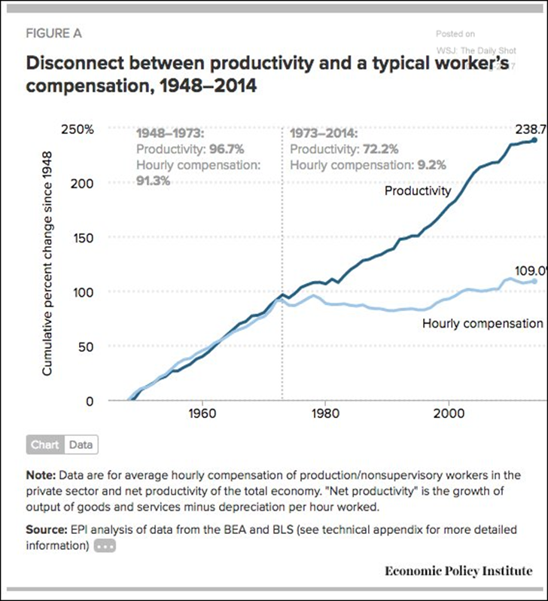
Story 1: The marginalist thinking - You deserve what you get Two interpretations
For many economists, „talent ideology” is a con, thanks to which CEOs can take over what others have created.
The impact of a CEO on company performance is not measurable, which is the nub of the issue. They have this 'talent ideology' to justify this. But is their ability so rare? I think it's a con.
https://www.bbc.com/worklife/article/20210125-why-ceos-make-so-much-money
Piketty also used a sort of marginalistic approach to show that something is wrong when analysing the data. If the increase in workers’ productivity and the increase in compensation are compared, then there is a gap that is difficult to explain.

Slide 59
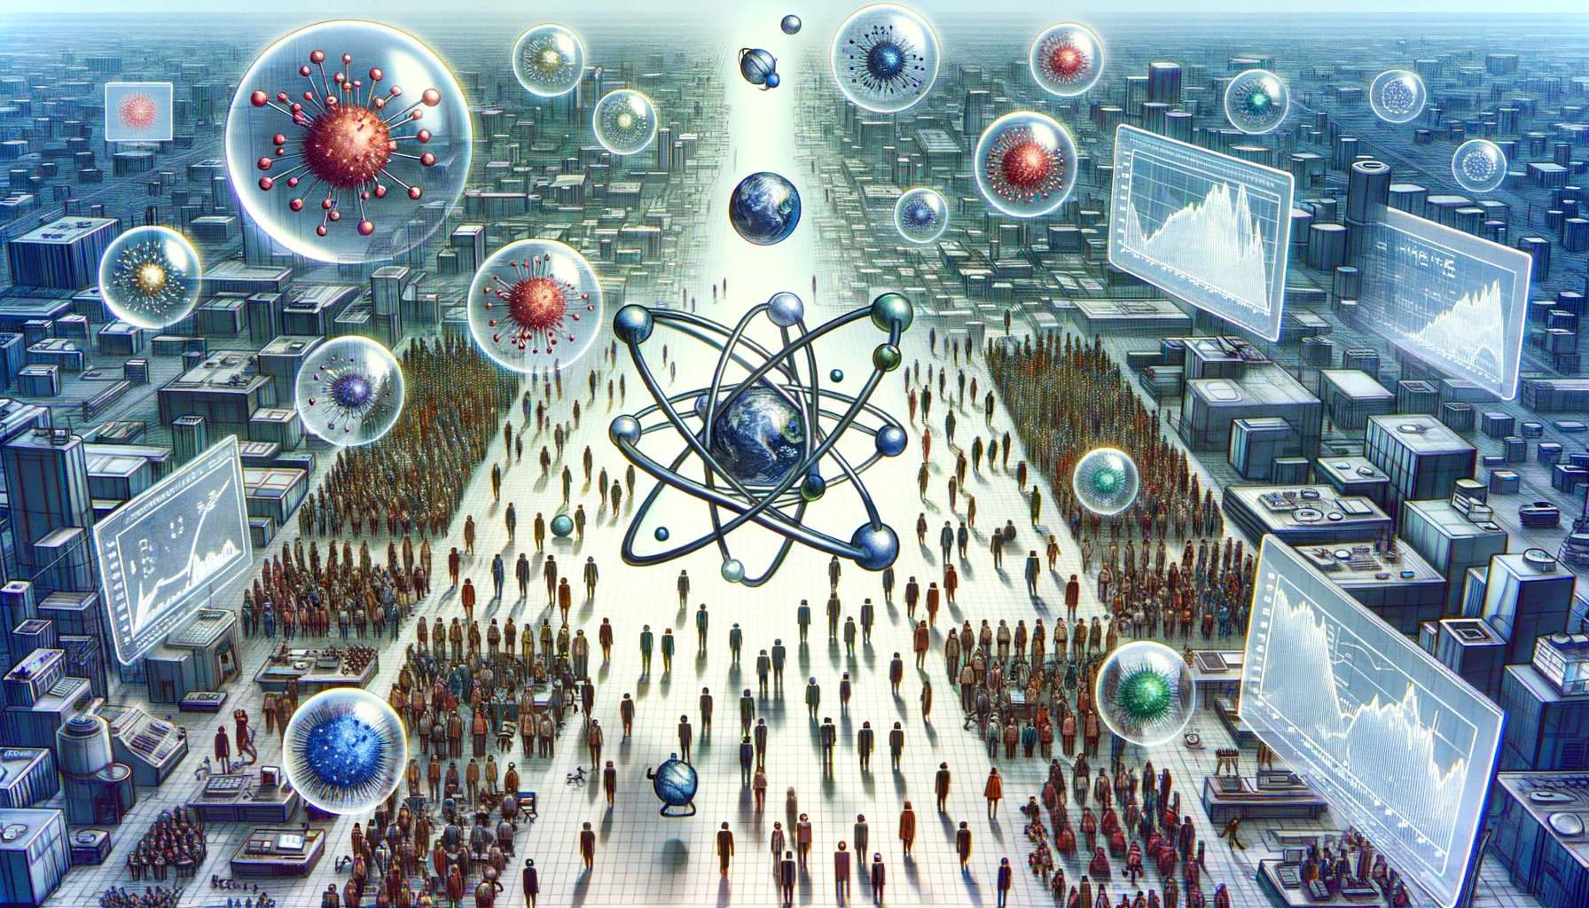
Story 2: In economic theory, we are atoms operating in a perfectly competitive market.
The image depicts a vast and interconnected market landscape that blends the essence of a bustling city with abstract elements. At the center, individuals, represented as "atoms", are actively engaging in various interactions, each encapsulated within transparent bubbles, symbolizing their individual autonomy in a perfectly competitive market. Floating digital screens displaying various economic charts and graphs further emphasize the concept.
OpenAI. (2023). ChatGPT (September 25 Version) [Large language model]. https://chat.openai.com

Slide 60
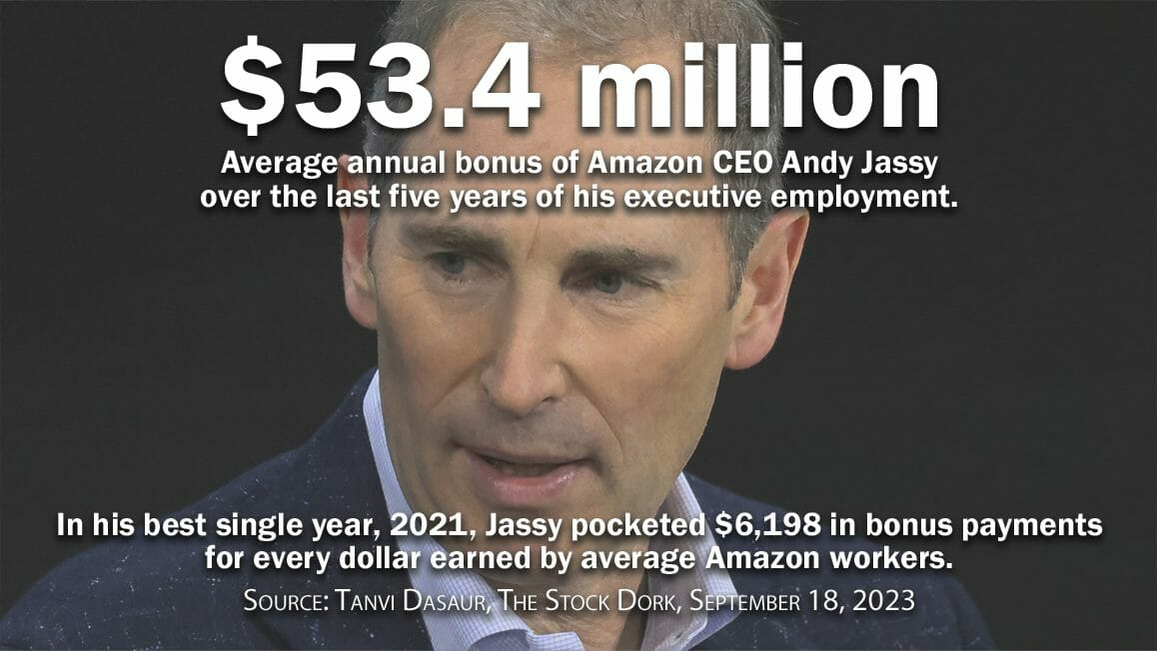
Story 2: we are atoms operating in a perfectly competitive market.
Teamwork or social interactions are not included in our calculations. In the model, the owner will employ people according to their individual productivity.
How to calculate individual CEO productivity. Profit? But the profit may be the result of the company's monopoly position and of course it is a team work result. At Amazon, the managing CEO earns a lot compared to ordinary workers. Is he a genius? No, only a successful bureaucrat who was lucky. What is his marginal productivity without a team? By the way: who is the Amazon’s owner?
https://inequality.org/wp-content/uploads/2023/09/inequality-newsletter-september-27-2023.html

Slide 61
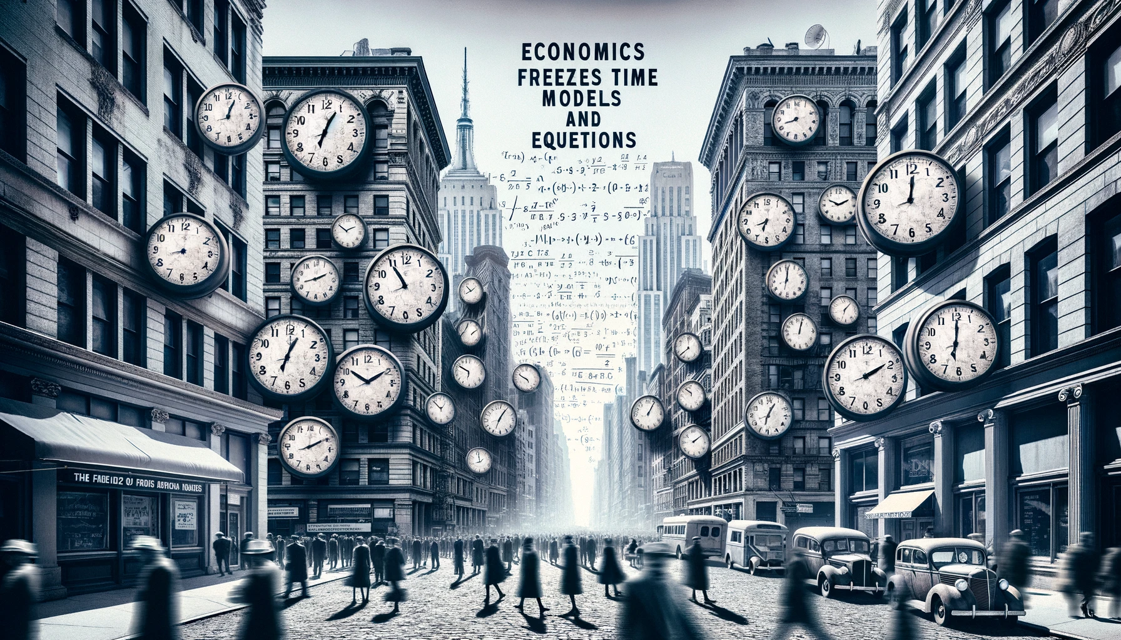
Story 3: "Economics freezes time in models and equations."
Apply the comparative statistic: compute equilibrium before and after the intervention and compare the conditions.
This means comparing two equilibrium points, and the transition from one to the other is instantaneous. We don't care what happens in the meantime. In economics, we have frozen time --> we have fully deterministic models, we know the new equilibrium point, and thus, we ignore the time path from the first to second equilibrium points. We do not care about path dpendecnce , histeresis …. ( to be continuet)

Slide 62

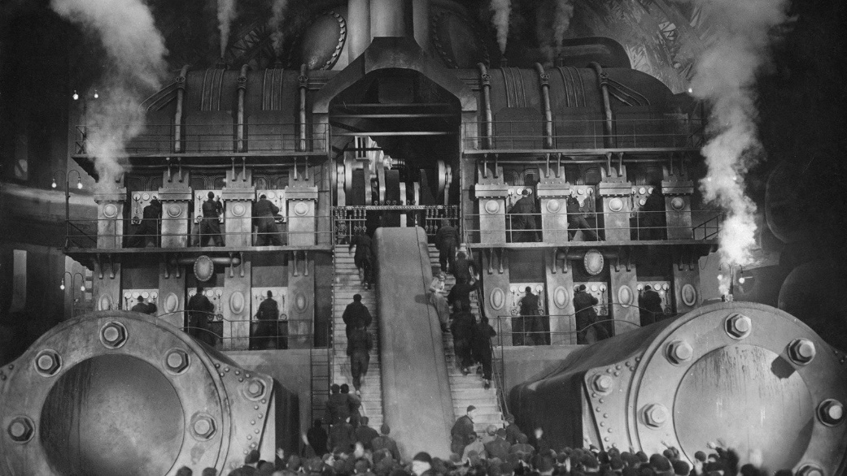
Story : we a maximalizing creatures we do no care about others, ethics, the environment, poverty and injustice.
Metropolis 1925 Fritz Lang
The image visualizes a futuristic urban landscape where individuals, depicted as robotic figures, are single-mindedly engaged in activities centered around maximizing profits and utility. These robotic personas move with precision, collecting coins, analyzing data, and operating machinery. Amidst their focused endeavors, aspects like a wilting plant representing environmental neglect, a broken scale symbolizing injustice, tattered banners with the word "ethics," and subtle hints of poverty are evident but overlooked. Above them, digital screens project equations and algorithms, underscoring the relentless pursuit of optimization at the expense of other considerations.

Slide 63
Story : we a maximalizing creatures we do no care about others, etics, the environment, poverty and injustice.
We behave like robots, the balance is the result of finding an optimization problem (maximizing profit, utility or minimizing cost), we do not take any action if it does not bring profit, or we take any action when it will increase our profit. Try to find the words: altruizm, morality and ethics in a microeconomics textbook. In economic theory we a maximalizing creatures we do no care about etics, the environment, poverty and injustice.
In my opinion, most of the chapters in the microeconomics textbook are the implementation of Ayan Rand's postulates --> our basic obligation is to be selfish. I know, textbook models are very simple but it shape our perception of reality. People mixt the model thinking with the with normative guidelines.

Slide 64
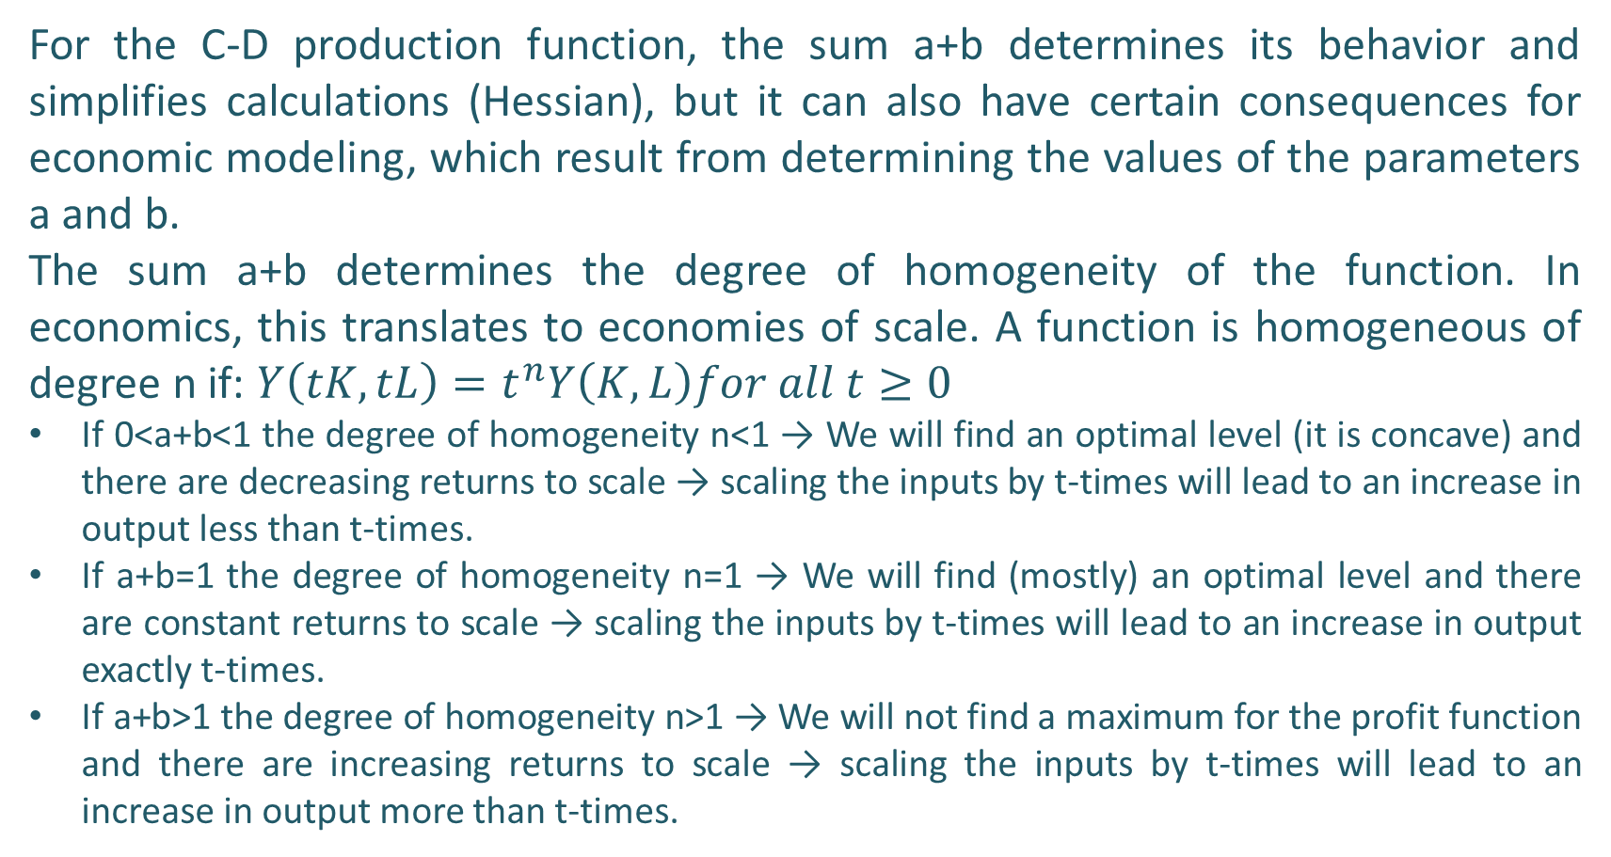
Story: Economies of scale and scope
kill(all)$
assume(K>0,L>0, t>1,A>0,a>0,b>0)$
a:0.3 $
b:0.5 $
A:20$
Y: A*(K)^a*(L)^(b)$
Y1: A*(t*K)^a*(t*L)^(b)$
eq1: Y1 =Y*t^n$
print(" The function is homogeneous of degree" , solve (eq1,n))$
For the C-D production function, the sum a+b determines its behavior and simplifies calculations (Hessian), but it can also have certain consequences for economic modeling, which result from determining the values of the parameters a and b.
The sum a+b determines the degree of homogeneity of the function. In economics, this translates to economies of scale. A function is homogeneous of degree n if: $Y\left(tK,tL\right)=t^{n}Y\left(K,L\right)for all t≥0$
If 0<a+b<1 the degree of homogeneity n<1 → We will find an optimal level (it is concave) and there are decreasing returns to scale → scaling the inputs by t-times will lead to an increase in output less than t-times.
If a+b=1 the degree of homogeneity n=1 → We will find (mostly) an optimal level and there are constant returns to scale → scaling the inputs by t-times will lead to an increase in output exactly t-times.
If a+b>1 the degree of homogeneity n>1 → We will not find a maximum for the profit function and there are increasing returns to scale → scaling the inputs by t-times will lead to an increase in output more than t-times.

Slide 65
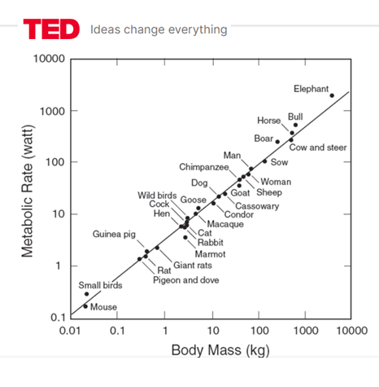
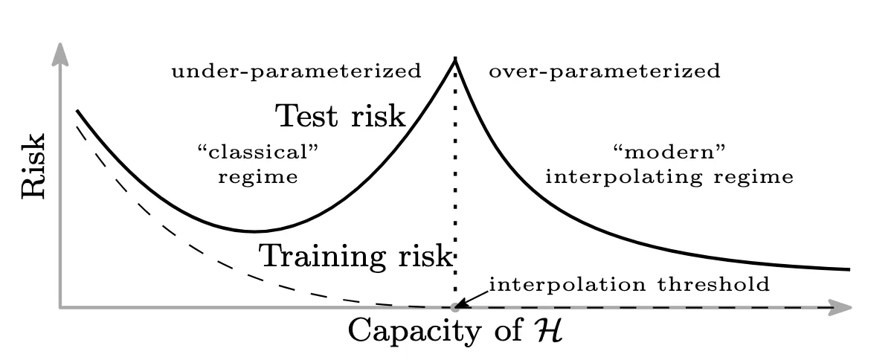
Economies of scale story – we (economists) do not care ☹
In economics, scalability is often illustrated with a single slide, showing that beyond a certain point, economies, markets, or production experience diminishing returns to scale, which ensures existence quilibrium.
Physicists have delved into scalability and proposed it as a fundamental law of nature. Check out this TED talk: https://www.ted.com/talks/geoffrey_west_the_surprising_math_of_cities_and_corporations?
In data science, the economies of scale work strangely; developers were surprised by the "overfeeding" of AI models. After reaching a specific threshold, the link between model capacity (H) and risk is transformed.
Read more here: https://arjunahuja.medium.com/double-descent-8f92dfdc442f
Watch: https://www.youtube.com/watch?v=QO5plxqu_Yw

Slide 66
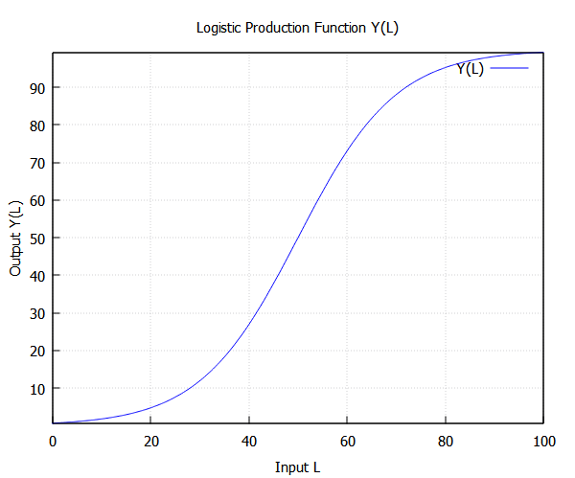
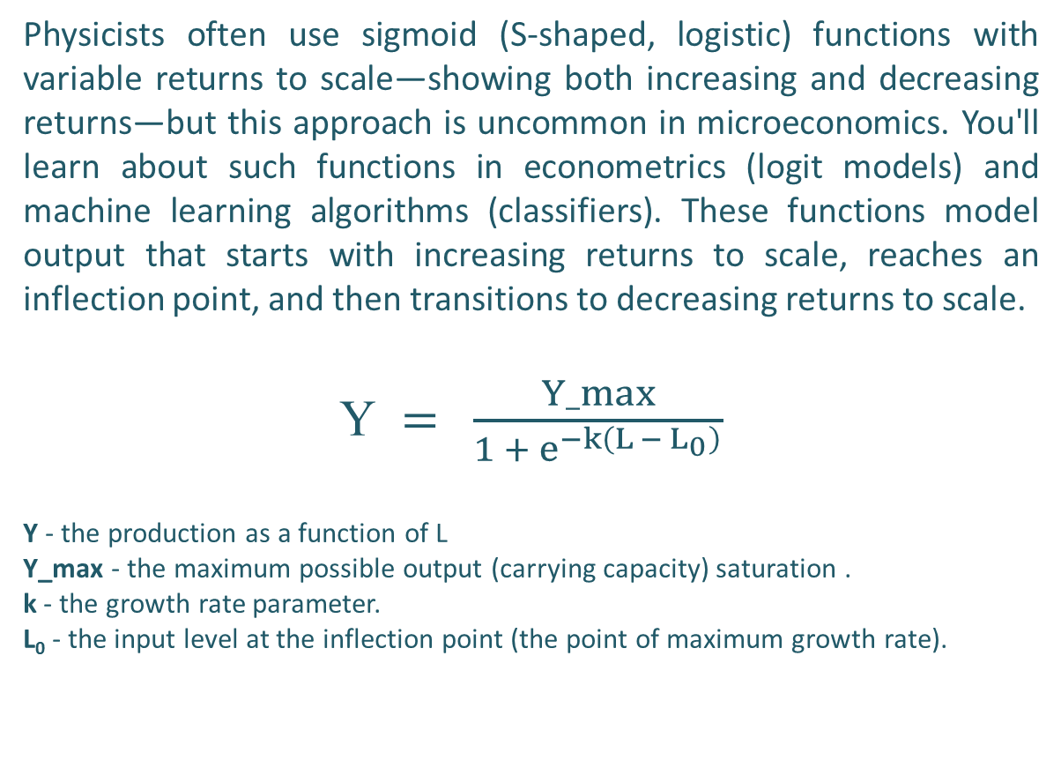
Economies of scale story – we (economists) do not care ☹
Physicists often use sigmoid (S-shaped, logistic) functions with variable returns to scale—showing both increasing and decreasing returns—but this approach is uncommon in microeconomics. You'll learn about such functions in econometrics (logit models) and machine learning algorithms (classifiers). These functions model output that starts with increasing returns to scale, reaches an inflection point, and then transitions to decreasing returns to scale.
Y$= \frac{Y_max}{1 + e^{−k\left(L − L_{0}\right)}}$
Y - the production as a function of L
Y_max​ - the maximum possible output (carrying capacity) saturation .
k - the growth rate parameter.
L₀ - the input level at the inflection point (the point of maximum growth rate).
After exceeding a certain level of L, scale effects decrease—production grows more slowly until it reaches saturation.
In microeconomics, we typically use Cobb-Douglas functions assuming diminishing returns to scale.

Slide 67
Economies of scale story – we (economists) do not care ☹
In microeconomics, we typically use Cobb-Douglas functions with diminishing returns to scale. This simplifies the interpretation of parameters (interpretation of MP-s) and results and ensures we find a unique solution to the optimization problem. Using an S-shaped function is already complex with one variable; now imagine extending it to functions of two variables, K and L.
kill(all);
load(draw)$
/* Define parameters for the logistic production function */
Ymax: 100$ /* Maximum possible output (carrying capacity) */
k: 0.1$ /* Growth rate parameter */
L0: 50$ /* Input level at the inflection point (maximum growth rate) */
/* Declare L real and assume L >0 */
declare(L, real)$ assume(L>0)$
/* Define the logistic production function Y as an expression in terms of L */
Y : Ymax / (1 + exp(-k * (L - L0)))$
/* Define the range of input L over which to evaluate the function */
Lmin: 0$ /* Minimum value of input L */
Lmax: 100$ /* Maximum value of input L */
/* Calculate the derivative of Y with respect to L (Marginal Product) */
dYdL_simplified : ratsimp(diff(Y, L))$
/* Display the simplified derivative */
print("Derivative of Y with respect to L (Marginal Product):",dYdL_simplified)$
draw2d(
title = "Marginal Product dY/dL",
xlabel = "Input L",
ylabel = "Marginal Product dY/dL",
grid = true,
key = "dY/dL",
explicit(dYdL_simplified, L, Lmin, Lmax) )$
kill(all);
/* Define the parameters of the production function */
Y_max: 100; /* maximum level of production */
k1: 0.5; /* growth rate for capital */
k2: 0.3; /* growth rate for labor */
k3: 0.1; /* growth rate for the interaction between capital and labor */
K0: 10; /* inflection point for capital */
L0: 10; /* inflection point for labor */
KL0: 100; /* inflection point for the interaction of K and L */
/* Define the production function */
Y: Y_max / (1 + exp(-k1 * (K - K0)) * exp(-k2 * (L - L0)) * exp(-k3 * (K * L - KL0)));
draw3d(
xlabel = "Capital (K)",
ylabel = "Labor (L)",
zlabel = "Production (Y)",
title = "Production Function with Interaction Between Capital and Labor", /* Title of the plot */
contour = both,
palette = gray,
grid = true,
explicit(Y, K, 0, 20, L, 0, 20)/* Define the function and ranges for K and L */ );
kill(all);
load(draw)$
/* Define parameters for the logistic production function */
Ymax: 100$ /* Maximum possible output (carrying capacity) */
k: 0.1$ /* Growth rate parameter */
L0: 50$ /* Input level at the inflection point (maximum growth rate) */
/* Declare L as a symbolic variable and assume L >0 */
declare(L, real)$ assume(L>0)$
/* Define the logistic production function Y as an expression in terms of L */
Y : Ymax / (1 + exp(-k * (L - L0)))$
/* Define the range of input L over which to evaluate the function */
Lmin: 0$ /* Minimum value of input L */
Lmax: 100$ /* Maximum value of input L */
draw2d(
title = "Logistic Production Function Y(L)",
xlabel = "Input L",
ylabel = "Output Y(L)",
grid = true,
key = "Y(L)",
explicit(Y, L, Lmin, Lmax))$

Slide 68
Economies of scope story – we (economists) do not care ☹
In traditional microeconomics, production functions usually describe one output as a function of several inputs: 𝑌=𝑓(𝐾,𝐿). This setup assumes single-purpose production — every input contributes to only one final good. However, real firms often produce multiple outputs that share resources, technologies, or knowledge.
The model cannot represent economies of scope — the cost advantage of producing several goods together rather than separately. Synergy, learning effects, and co-production (e.g., data → AI → product improvement) remain invisible to classical micro theory.
Economies of scope remind us that real-world production is not additive —it’s emergent. The whole can be more than the sum of its parts. Why do Apple produce both hardware and software in-house? Because their outputs reinforce each other — scope, not scale, drives efficiency.

Slide 69
Why Computer Algebra System PART 2

Slide 70
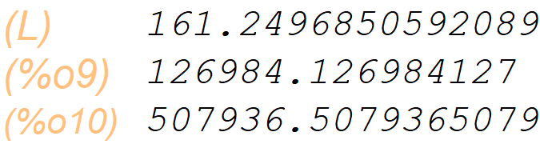

Cost-benefit analysis of using symbolic computation in intermediate microeconomics
Apply the comparative statistic: compute equilibrium before and after the intervention and compare the conditions. It means we have to solve two optimization problems:
$$1. \max_{L}{(10(10000L^{0.5}) −3150L)}$$
$$2.{\max_{L}{( 10(1−0.2)(10000L^{0.5}) −3150L)}}$$
kill(all)$
/* prices */
p:10;
t: 0.2;
w:3150;
/* enter the production function */
y:10000*L^0.5;
/* enter the profit function */
profit: p*(1-t)*y - w*L;
/* calculate f.o.c*/
eq1: diff(profit,L,1) = 0;
float(solve (eq1,L));
L : rhs(%[1]);
ev(y);
ev(profit);
kill(all)$
/* prices */
p:10;
w:3150;
/* enter the production function */
y:10000*L^0.5;
/* enter the profit function */
profit: p*y - w*L;
/* calculate f.o.c*/
eq1: diff(profit,L,1) = 0;
float(solve (eq1,L));
L : rhs(%[1]);
ev(y);
ev(profit);
The profitability of using CAS is not so obvious. For the standard tasks, of course, it is profitable, but for non-standard, you have to code, which is costly (the high sunk cost of learning a new language, time to programming)

Slide 71
Cost-benefit analysis of using symbolic computation in intermediate microeconomics
Does using CAS as a scientific calculator give us some value-added in this type of task, but not a significant one. So what, that we get point results quickly, it is still the duplication of textbook examples. And the more fundamental question arises: why did you calculate a lot of the equilibria conditions on the intermediate level?
…. to remember the conditions of equilibria and the approximation of the behaviour of the model. You should remember that some variable goes up, down, stays at the same level after the intervention. Can we argue about the actual behaviour of the market based on these results? Or can we conclude about the behaviour of the model more deeply? Not really. But maybe at the advanced level, you will start (?)

Slide 72
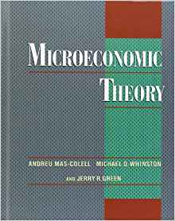
Cost-benefit analysis of using symbolic computation in advanced microeconomics
At the advanced level, you will conclude about the behaviour of the model but not as you expect - you will have to prove some mathematical properties of the obtained results (is the function concave or convex, does it have its maximum or minimum, under what conditions the function behaves well - what properties of the function guarantee obtain the extrema. And you completely forget about the question about the reality of these models.
Microeconomic Theory (Mas-Colell, Whinston and Green) is the most known textbook of advanced microeconomics. The text mining analysis of the book (Johansson, 2004) shows that there are no words like entrepreneurship or institution in the book.

Slide 73
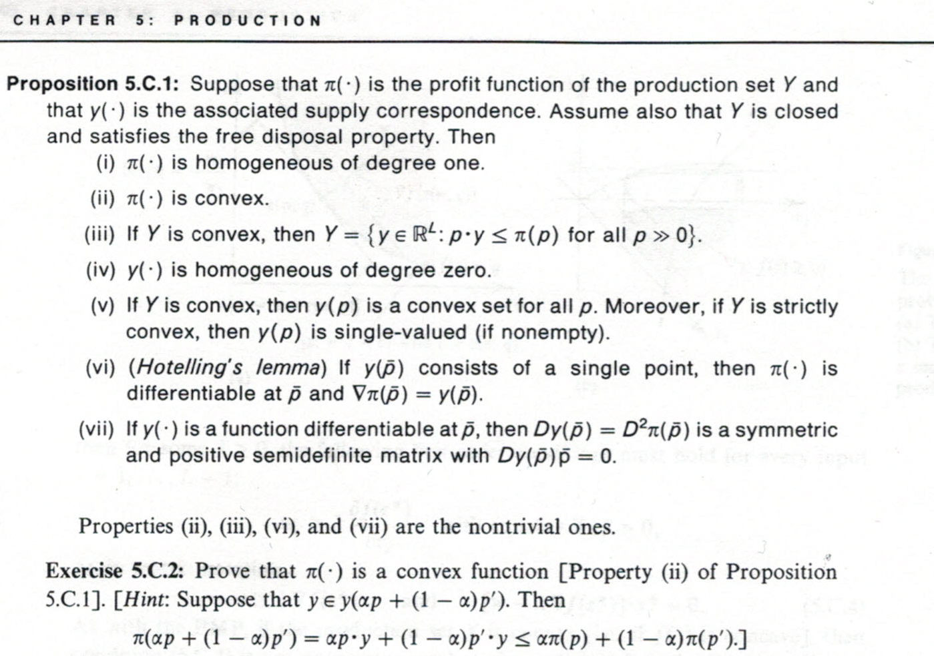
The second reason (methodical) to introduce symbolic computation to microeconomics?
The last exercise was based on our demand for labour model, which is from "Mas-Colell". The whole handbook is like that - theorems and proofs.
Distinguishing this book from the handbook of formal (axiomatic) mathematics is very hard.
How to escape from the dichotomy: meaningless calculations or „Mas-Colell” formal (axiomatic) Microeconomics?

Slide 74



The second reason (methodical) to introduce symbolic computation to microeconomics?
I found the way how to use symbolic computation and Computer Algebra System (CAS) and create significant value-added in microeconomics itself. ...... When we start using the CAS base on the characteristics of the work environment. And do not replicate pen-and-paper textbook calculations.
It can be a game-changer but I know it will not be popular at all. Economists very often confuse the logical - internal validity of the model with external validity* and CAS easily show any non-consistency of internal and external validity.

Slide 75
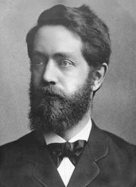
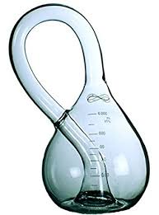
The second reason (methodical) to introduce symbolic computation to microeconomics?
My inspiration: Forgotten reform of teaching mathematics proposed by Felix Klein (1905). His postulates of mathematic reform were:
incorporate model thinking and to get rid of units of measure
the solution of the problem should be presented as a function
visualization of the results
Felix Klein
1849 –1925
There is a lot of similarities between microeconomic education problems nowadays and problems with the mathematical education of engineers at the beginning of the XX century.
the teaching of mathematics at a primary level was based on the mechanical repetition of calculations.
there was domination of formalism in academic mathematics (Russel and the Burbaki group)
The aim of mathematics education reformers was to create a coherent learning pathway from primary school to university which is adapted to the needs of engineers.

Slide 76
The second reason (methodical) to introduce symbolic computation to microeconomics?
Klein himself described an ideal tool to implement his postulates - calculating machine. The CAS software made it possible to implement his postulates fully. And for us, it can be the first step to implement postulates on how to change doing mathematics in economics and start thinking like engineers or physicists*. We can experiment with the theoretical model, just as in laboratories. We can adopt a rather naive but cognitively interesting approach: let us treat literally models presented in textbooks, just as the engineer treats the mathematical model of the designed structures. By experimenting with these models, let us learn the mechanics of it and determine the realism (external validity) of their behaviour.
Please read and discuss McCloskey article on the forum: https://www.deirdremccloskey.com/articles/stats/stats.php

Slide 77
The second reason (methodical) to introduce symbolic computation to microeconomics?
We have to answer the question ourselves: is the model a surrogate of reality or its substitute (Mäki, 2005).
External validity is not a question that can be answered scientifically, although, as
we have seen, imaginative empirical methods do help. A lot hangs on what is essentially analogical reasoning. As Robert Sugden puts it, “The gap between the model world and the real world has to be crossed by inductive inference . . . [and this] depends on subjective judgments of ‘similarity,’ ‘salience,’ and ‘credibility.’ ” While we can imagine expressing concepts such as “similarity” in formal or quantitative terms, this formalization won’t be helpful in most contexts. There is an unavoidable craft element involved in rendering models useful.
[Economics Rules by Dani Rodrik - I recomend the book]

Slide 78
The second reason (methodical) to introduce symbolic computation to microeconomics?
Let implement the postulates to our simple labour demand model:
We can present the L, Y, profit as a function on w and t of and visualize obtained functions. We treat t and w as a variables and do not enter its specific values. It is a simple modification of previous codes and adding drawing
We can simply extend the analysis and find the behaviour of tax revenue T = t*p*Y as a function of t. we can create something lake Laffer Curve and we can find the optimum rate of tax that maximize tax revenues T.
Using the graphical interface we can analyse the behaviour of all these functions
We can try to judge - are behaviours of these functions realistic or not.
It will be you todays lecture report.

Slide 79
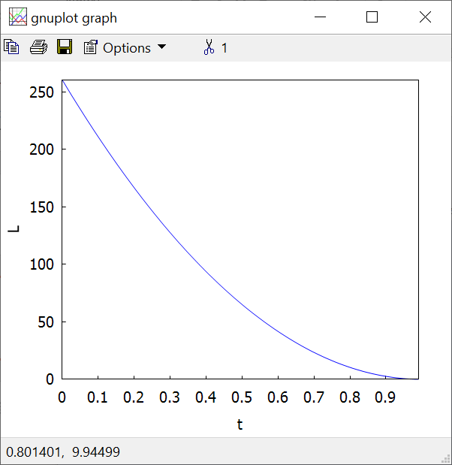
The second reason (methodical) to introduce symbolic computation to microeconomics?
The behaviour of the function seems OK, but ….
I am not going to discuss the behaviour of the function - it will be your goal of today's lecture report. It should be your subjective judgment. Today, I give you easy to use computational tools. I present my interpretation as comments to your reports.
It is a labour function with
respect to the tax rate L(t).
kill(all)$
assume(1- t >0);
/* prices tax*/
p: 10*(1-t);
w: 3100;
/* enter the production function */
y: 10000*L^0.5;
/* enter the profit function */
profit: p*y - w*L;
/* calculate f.o.c*/
eq1: diff(profit,L,1) = 0;
float(solve (eq1,L));
L : rhs(%[1]);
draw2d(
xlabel = "t",
ylabel = "L",
explicit(ev(L), t,0,0.99));

Slide 80
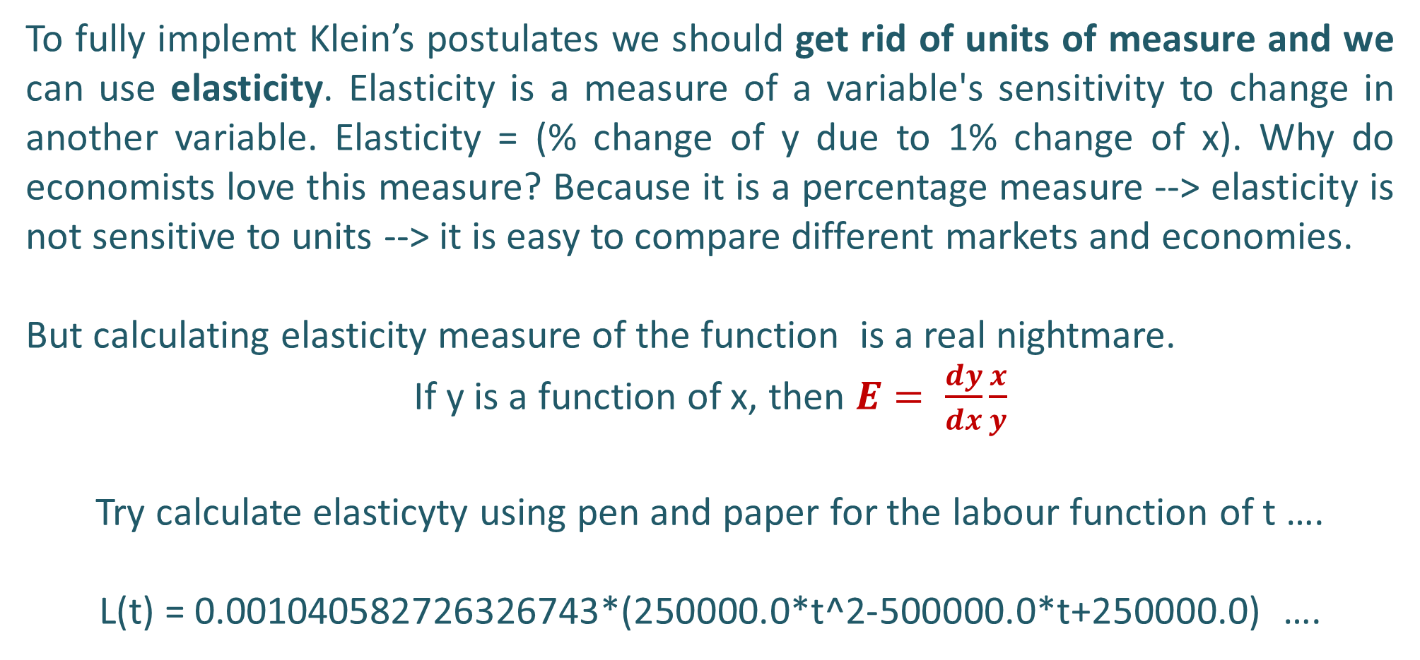
The second reason (methodical) to introduce symbolic computation to microeconomics?
To fully implemt Klein’s postulates we should get rid of units of measure and we can use elasticity. Elasticity is a measure of a variable's sensitivity to change in another variable. Elasticity = (% change of y due to 1% change of x). Why do economists love this measure? Because it is a percentage measure --> elasticity is not sensitive to units --> it is easy to compare different markets and economies.
But calculating elasticity measure of the function is a real nightmare.
If y is a function of x, then $E= \frac{dy}{dx}\frac{x}{y}$
Try calculate elasticyty using pen and paper for the labour function of t ….
L(t) = 0.001040582726326743*(250000.0*t^2-500000.0*t+250000.0) ….

Slide 81
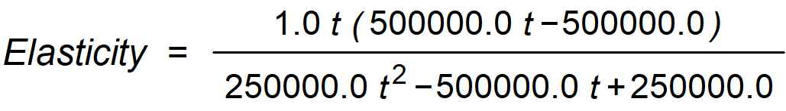
The second reason (methodical) to introduce a Computer Algebra System to microeconomics?
kill(all)$
assume(1- t >0);
/* prices tax*/
p: 10*(1-t);
w: 3100;
/* enter the production function */
y: 10000*L^0.5;
/* enter the profit function */
profit: p*y - w*L;
/* calculate f.o.c*/
eq1: diff(profit,L,1) = 0;
float(solve (eq1,L));
L : rhs(%[1]);
E_t: diff(L,t,1)* (t/L);
print("Elasticity = ", E_t)$
draw2d(
xlabel = "t",
ylabel = "Elasticity",
explicit(ev(E_t), t,0,0.99));
Make your life easier use Maxima - you need only change four lines of code
Symbolic solution
Green codes were added/ changed

Slide 82
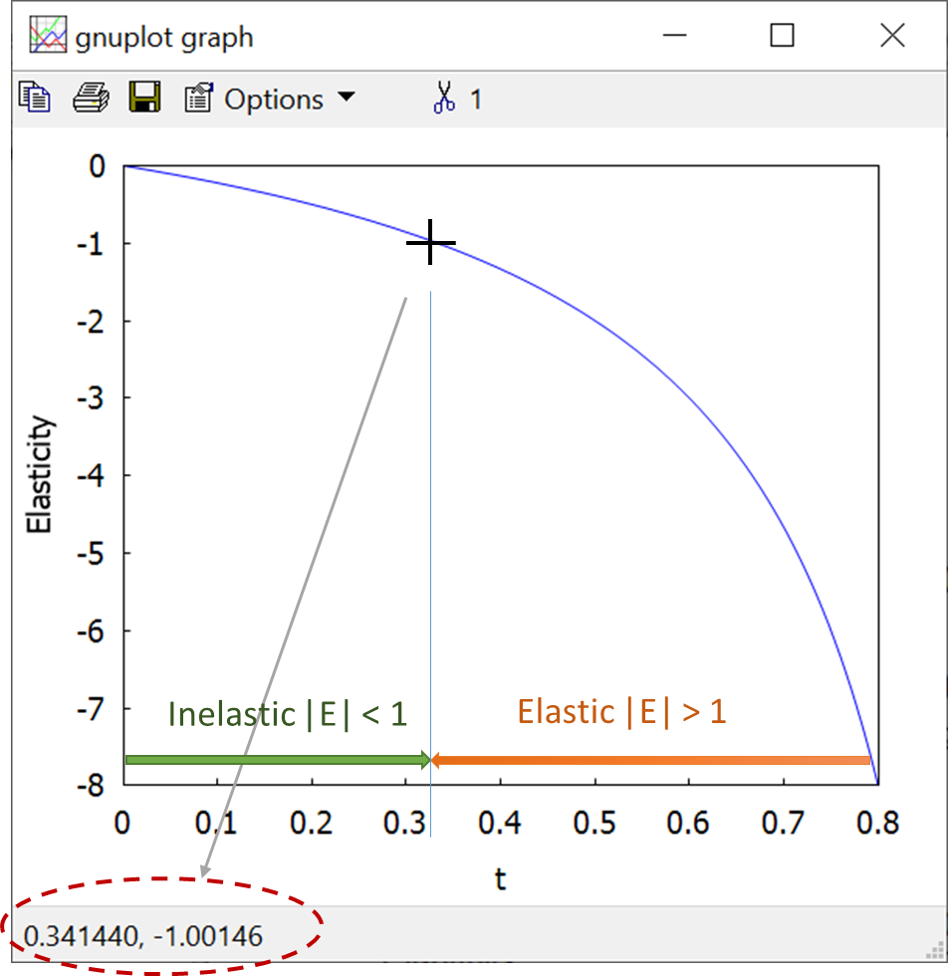
The second reason (methodical) to introduce a Computer Algebra System to microeconomics?
Interpretation:
For the tax rate between 0 and ~34 %, the labour function is inelastic. L(t) weakly react to tax rate change). ....For a tax rate greater than 34% the function is elastic and the elasticity grows fast.
Example: for tax rate t = 0.50
1 % increase in tax rate [It is a minimal change in tax rate from 0.5 to 0.505) reduces employment by more than 2% (E ~ 2.04) and it is a massive reduction in employment.
Is the behaviour of the model realistic or not?

Slide 83
The second reason (methodical) to introduce a Computer Algebra System to microeconomics?
Ok, you may say that these numbers are completely artificial. Yes, you are right, but:
These types of functions are placed in the General Equilibrium models, and we should know that the strange behaviour of the function affects the result of this type of calculation.
We can forget about calculation and can focus on how to relate the model to real problems.
Each year there is a new theme (a leitmotif) of my microeconomic lectures. One of them was health - obesity and civilization diseases. For example, this simple model can be a base to analyze the impact of a sugar tax on the economy. What is the tax burden on candy sales (soda drinks), and how will the introduction of the sugar tax affect employment in the sector? Is the model realistic?

Slide 84

Why do we love Cobb-Douglas (C-D) production functions?
Contunued
kill(all)$
/* Define the production function Y as a function of K and L */
Y : A * L^α* K^β;
/* Compute the partial derivatives of Y with respect to K and L */
dYdK : diff(Y, K,1);
dYdL : diff(Y, L, 1);
/* Calculate the elasticity of Y with respect to K and L */
/* Simplify the elasticity expression */
E_Y_K : ratsimp((dYdK * K) / Y) $
E_Y_L : ratsimp((dYdL * L) / Y) $
print("Elasticity of Y with respect to K is:", E_Y_K)$
print("Elasticity of Y with respect to L is:", E_Y_L)$
In the C-D production function, the parameters (exponents) α and β are defined as elasticities:
α: the percentage by which production increases when employment increases by 1%.
β: the percentage by which production increases when capital increases by 1%.
It's great that these parameters are constants in the C-D function, simplifying calculations and interpretations. However, this simplicity might not always align with reality. For example, if a company's employment increases by 10%—from 10 employees to 11—the production increases by α×10%. The same percentage increase applies when going from 10,000 to 11,000 employees. Assuming returns in this way may not accurately reflect real-world scenarios.

Slide 85
The Third Reason a Computer Algebra System Will Be a Part of AI — We Have to Learn How to Use It
Artificial Intelligence develops by integrating symbolic and statistical reasoning. A Computer Algebra System (CAS) represents the symbolic core of intelligence —it performs logical, rule-based manipulation of knowledge (not pattern matching).
Learning CAS today means learning how AI thinks — not only how it predicts, but how it derives.
When we use CAS in microeconomics, we teach ourselves to:
understand the formal logic behind economic models,
verify internal validity (symbolic reasoning), and connect it with empirical learning (data, AI, machine reasoning).
Just as neural networks imitate intuition, CAS represents reason. Modern AI combines both — symbolic and connectionist thinking. To use AI critically, we must understand both.
We introduce CAS because it helps us transition from “AI as a calculator” to “AI as a collaborator.” In this sense, learning CAS is not optional — it is a way to becomean intelligent user, not a passive consumer of AI-generated results.

Slide 86
To do
Lecture report (in progress) will be based on the last exam task – how to use AI and CAS to evaluate a top-ranked article.
You have a lot of discussion topics on the forum - you do not use the tool to get more $FBEE
Practice running ready to use Maxima codes (file: Minimalist Introduction to Maxima). I stopped hoping that I would force students to learn Maxima just before the end of the study. But you have to know how to run and modify the codes. After all, it will be a valuable skill on the exam. Make AI to do it.

